Slide 1


Enabling Accurate, Fast, and Memory-Efficient Genome Analysis via Efficient and Intelligent Algorithms
Can Firtina
canfirtina@gmail.com
27 May 2022
Invited Seminar Talk at UC Berkeley

Slide 2
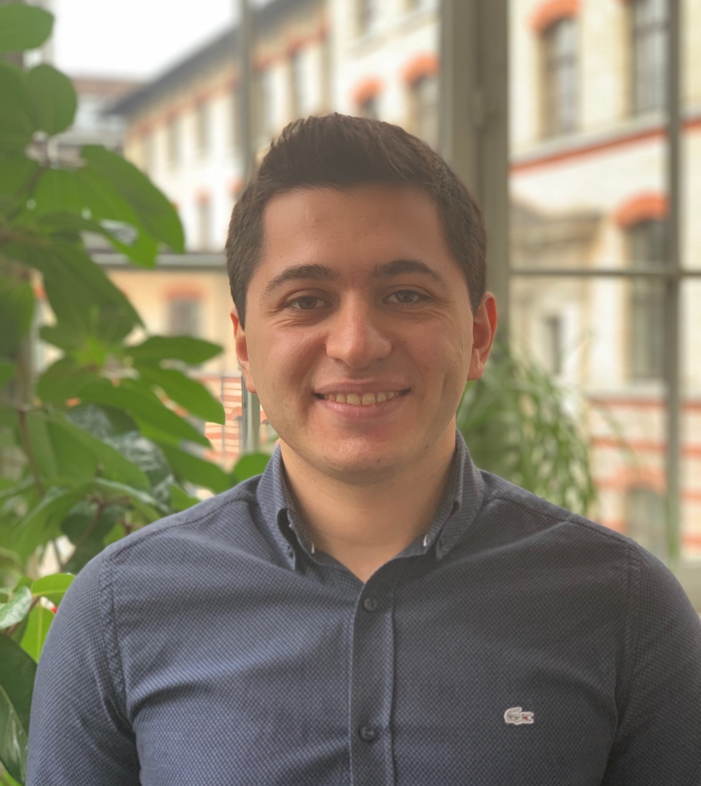
Brief Self Introduction
Ph.D. Student in the SAFARI Research Group
Research interests:
Computational biology, accelerating genome analysis, genome editing
Some selected works:
C. Firtina+, "ApHMM: A Profile Hidden Markov Model Acceleration Framework for Genome Analysis," arXiv, May 2022.
C. Firtina+, "BLEND: A Fast, Memory-Efficient, and Accurate Mechanism to Find Fuzzy Seed Matches," arXiv, December 2021.
Jeremie S. Kim, C. Firtina+ "AirLift: A Fast and Comprehensive Technique for Translating Alignments between Reference Genomes," bioRxiv, Feb. 2021.
C. Firtina+, "Apollo: a sequencing-technology-independent, scalable and accurate assembly polishing algorithm," Bioinformatics, Jun. 2020.
Get to know us and our research
https://safari.ethz.ch/
Contact me: canfirtina@gmail.com. Personal website: https://cfirtina.com

Slide 3
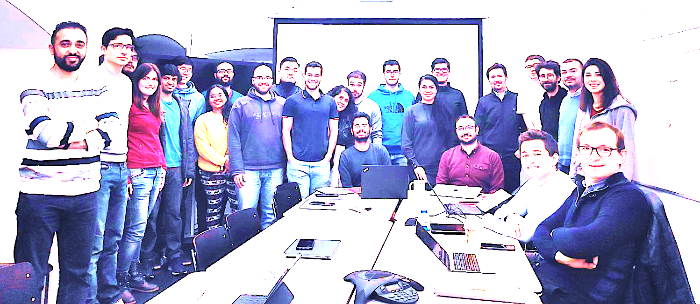

Onur Mutlu’s SAFARI Research Group
Computer architecture, HW/SW, systems, bioinformatics, security, memory
40+ Researchers
Think BIG, Aim HIGH!
https://safari.ethz.ch
Notes:
We have 40+ researches in SAFARI. Our group focuses on many topics such as computer architecture, security, and bioinformatics.
Our motto is Think big, Aim High ☺

Slide 4
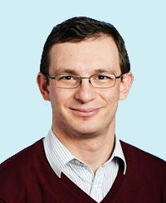
Professor Mutlu
Onur Mutlu
Full Professor @ ETH Zurich ITET (INFK), since September 2015
Strecker Professor @ Carnegie Mellon University ECE/CS, 2009-2016, 2016-…
PhD from UT-Austin, worked at Google, VMware, Microsoft Research, Intel, AMD
https://people.inf.ethz.ch/omutlu/
omutlu@gmail.com (Best way to reach)
https://people.inf.ethz.ch/omutlu/projects.htm
Research and Teaching in:
Computer architecture, computer systems, hardware security, bioinformatics
Memory and storage systems
Hardware security, safety, predictability
Fault tolerance
Hardware/software cooperation
Architectures for bioinformatics, health, medicine
…
Notes:
Our group is led by Professor Onur Mutlu. He is a professor at ETH Zurich in the Information Tech. and Electrical Engineering department and also affifiliated with the CS department since 2015. Previously he was a professor at Carnegie Mellon university.
He received his PhD from UT-Austin and later worked at many companies such as Microsoft research, Google, Vmware, Intel and AMD. You can find more about him using his personal website and you can contact him using his gmail.

Slide 5
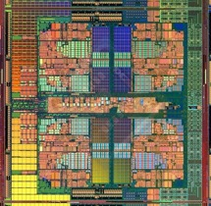
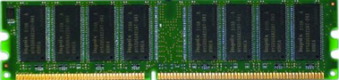
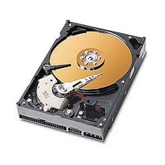
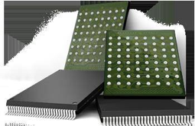
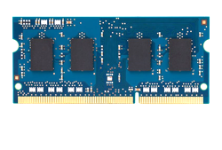
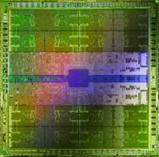
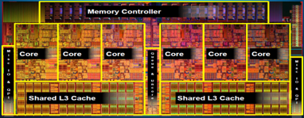
Current Research Mission
Computer architecture, HW/SW, systems, bioinformatics, security
Hybrid Main Memory
Heterogeneous
Processors and
Accelerators
Persistent Memory/Storage
Graphics and Vision Processing
Build fundamentally better architectures
Notes:
The research we do in SAFARI focuses all aspects of computer architecture, HW/SW interaction and bioinformatics.

Slide 6
Four Key Current Directions
Fundamentally Secure/Reliable/Safe Architectures
Fundamentally Energy-Efficient Architectures
Memory-centric (Data-centric) Architectures
Fundamentally Low-Latency and Predictable Architectures
Architectures for AI/ML, Genomics, Medicine, Health
Notes:
In our group, we mainly have four key directions. I will talk more about the fourth direction today.

Slide 7
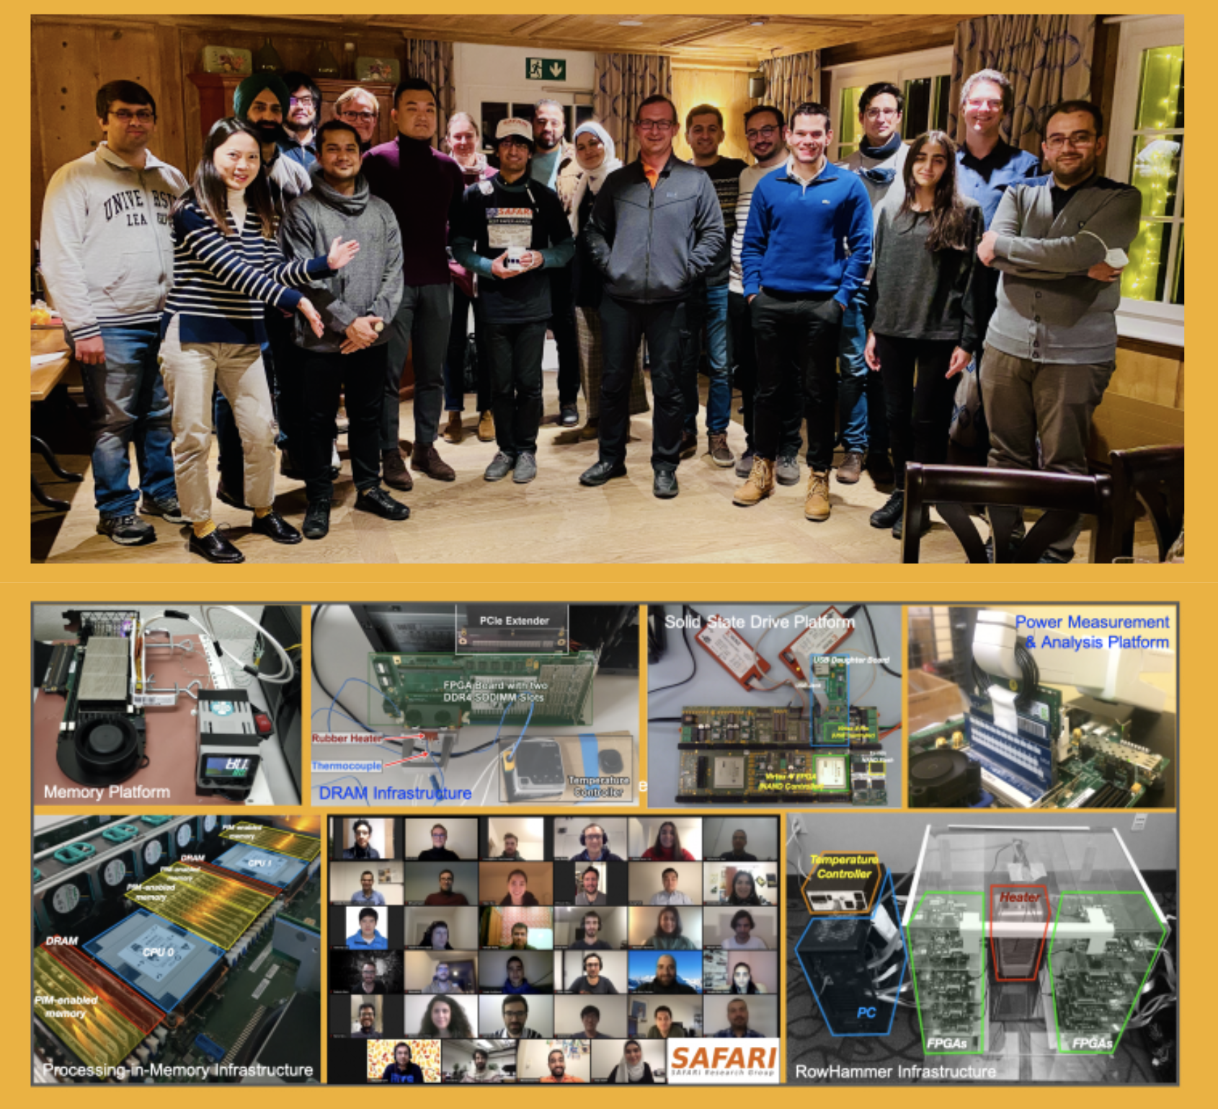
SAFARI Newsletter December 2021 Edition
https://safari.ethz.ch/safari-newsletter-december-2021
Notes:
We also periodically release newsletters where you can find the recent updates from our group.
Our most recent newsletter was released in December 2021

Slide 8
Research & Teaching: Some Overview Talks
https://www.youtube.com/onurmutlulectures
Future Computing Architectures
https://www.youtube.com/watch?v=kgiZlSOcGFM&list=PL5Q2soXY2Zi8D_5MGV6EnXEJHnV2YFBJl&index=1
Enabling In-Memory Computation
https://www.youtube.com/watch?v=njX_14584Jw&list=PL5Q2soXY2Zi8D_5MGV6EnXEJHnV2YFBJl&index=16
Accelerating Genome Analysis
https://www.youtube.com/watch?v=r7sn41lH-4A&list=PL5Q2soXY2Zi8D_5MGV6EnXEJHnV2YFBJl&index=41
Rethinking Memory System Design
https://www.youtube.com/watch?v=F7xZLNMIY1E&list=PL5Q2soXY2Zi8D_5MGV6EnXEJHnV2YFBJl&index=3
Intelligent Architectures for Intelligent Machines
https://www.youtube.com/watch?v=c6_LgzuNdkw&list=PL5Q2soXY2Zi8D_5MGV6EnXEJHnV2YFBJl&index=25
The Story of RowHammer
https://www.youtube.com/watch?v=sgd7PHQQ1AI&list=PL5Q2soXY2Zi8D_5MGV6EnXEJHnV2YFBJl&index=39
Notes:
We also make many materials available in YouTube such as the research and teaching we do in our group. You can watch these videos or visit our group’s YouTube channel to learn more.

Slide 9
Referenced Papers, Talks, Artifacts
All are available at
https://safari.ethz.ch
https://people.inf.ethz.ch/omutlu/projects.htm
http://scholar.google.com/citations?user=7XyGUGkAAAAJ&hl=en
https://www.youtube.com/onurmutlulectures
https://github.com/CMU-SAFARI/
Notes:
You can find more information for all the materials in our website.

Slide 10
Accelerating Genome Analysis
Notes:
Today, I will talk more about accelerating genome analysis using intelligent software and hardware designs.

Slide 11
The Problem
Computing
is Bottlenecked by Data
Notes:
The main problem that we are essentially intending to solve is computing is really bottlenecked by data today.

Slide 12
Data is Key for AI, ML, Genomics, …
Important workloads are all data intensive
They require rapid and efficient processing of large amounts of data
Data is increasing
We can generate more than we can process
Notes:
If you look at AI, ML, Genomics: All important workloads are really data intensive.
They require rapid and efficient analysis of large amount of data. And data is increasing.
We can generate much more data than we can process today

Slide 13
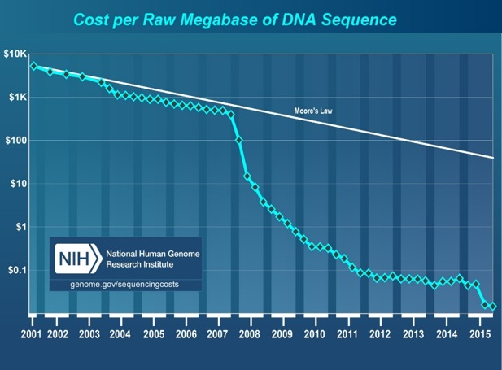
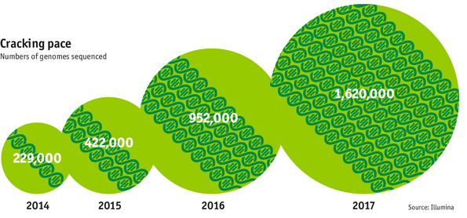

Data is Key for Future Workloads
development of high-throughput sequencing (HTS) technologies
Number of Genomes Sequenced
http://www.economist.com/news/21631808-so-much-genetic-data-so-many-uses-genes-unzipped
Notes:
The HTS technology is providing us with a lot of data because sequencing machines have become extremely high throughout and energy efficient
in a way that the genome analysis becomes much less costly faster than a transistor becomes much less costly with traditional Moore’s law curve. As a result we can sequence many genomes

Slide 14

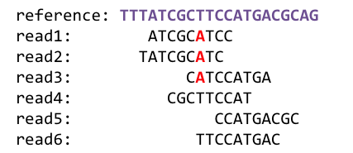
1
Sequencing
Genome Analysis
Read Mapping
2
Data → performance & energy bottleneck
Variant Calling
Scientific Discovery
3
4
Notes:
This can lead to many scientific discoveries, medical health advancements, better understanding of outbreaks and diseases.
[CLICK]
However, we are essentially limited by how fast and efficiently we can process this data.

Slide 15

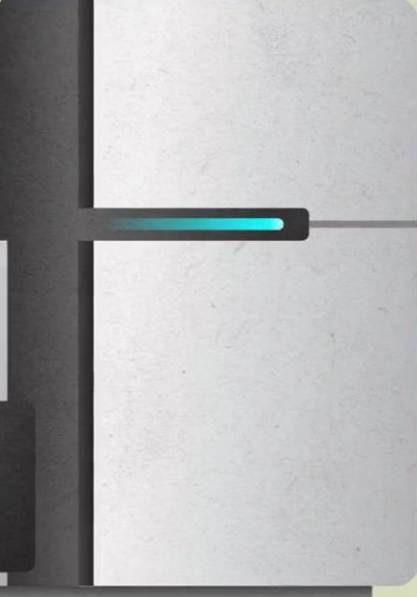

Lack of Specialized Compute Capability
Specialized Machine
for Sequencing
General-Purpose Machine
for Analysis
FAST SLOW
Notes:
These sequencing machines are not the bottleneck, the bottleneck is really the software and the hardware that analyze the sequencing data.
We are looking into a lot of approaches where we can co-design software and hardware so that we can reach the throughput of sequencing machines today so that we can for example enable doctors to make decisions very quickly based on the data they gather from someone’s genome so that they can make life-crytical decisions.

Slide 16


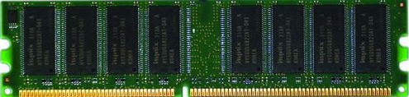
Data Movement Dominates Performance
Data movement dominates performance and is a major system energy bottleneck (accounting for 40%-62%)
Data Movement
Sequencing
Machine
Storage (SSD/HDD)
Main Memory
Microprocessor
Single memory request consumes >160x-800x more energy compared to performing an addition operation
✻ Boroumand et al., “Google Workloads for Consumer Devices: Mitigating Data Movement Bottlenecks,” ASPLOS 2018
★ Kestor et al., “Quantifying the Energy Cost of Data Movement in Scientific Applications,” IISWC 2013
☆ Pandiyan and Wu, “Quantifying the energy cost of data movement for emerging smart phone workloads on mobile platforms,” IISWC 2014
Notes:
Today, data movement dominates the performance because large chunks of data need to be stored in storage systems and
[CLICK]
moved between the CPU and main memory for genome analysis.
The CPU accesses off-chip main memory through a pin-limited bus known as the memory channel,
[CLICK]
and a high amount of data movement across the memory channel is extremely costly in terms of both execution time and energy.

Slide 17
Read Mapping Execution Time
>60%
of the read mapper’s execution time is spent in sequence alignment
minimap2
ONT FASTQ size: 103MB (151 reads), Mean length: 356,403 bp, std: 173,168 bp, longest length: 817,917 bp
Notes:
We observe that most of the total execution time is mainly spent for sequence alignment during read mapping. This is both because alignment computation is costly but also because

Slide 18


Large Search Space for Mapping Location
98%
of candidate locations have high dissimilarity with a given read
Cheng et al, BMC bioinformatics (2015)
Xin et al, BMC genomics (2013)
Notes:
We perform too many redundant alignment operations for sequence pairs that end up being unaligned, which leads to wasting compute cycles while verifying these locations.
H. Cheng, et al., "BitMapper: an efficient all-mapper based on bit-vector computing," BMC bioinformatics, vol. 16, p. 1, 2015.
H. Xin, et al., "Accelerating read mapping with FastHASH," BMC genomics, vol. 14, p. S13, 2013.

Slide 19
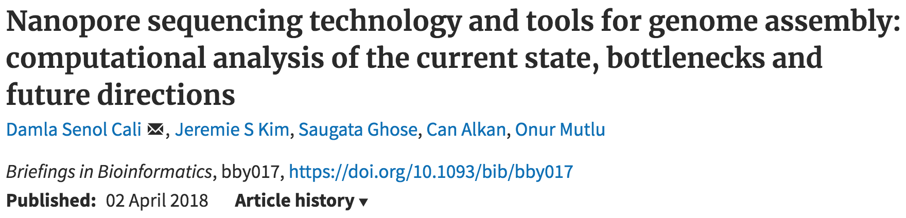
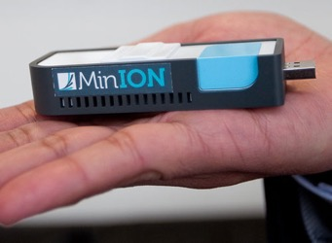
New Genome Sequencing Technologies
Oxford Nanopore MinION
Senol Cali+, “Nanopore Sequencing Technology and Tools for Genome
Assembly: Computational Analysis of the Current State, Bottlenecks
and Future Directions,” Briefings in Bioinformatics, 2018.
[Open arxiv.org version]
Notes:
You can read this paper if you are interested in learning more about the overheads involved in when using high throughput sequencing technologies such as Oxford Nanopore Sequencing technologies

Slide 20
New Genome Sequencing Technologies
Oxford Nanopore MinION
Senol Cali+, “Nanopore Sequencing Technology and Tools for Genome
Assembly: Computational Analysis of the Current State, Bottlenecks
and Future Directions,” Briefings in Bioinformatics, 2018.
[Preliminary arxiv.org version]
Data → performance & energy bottleneck
Notes:
However, the problem is really the analysis of data rather than the speed we generate this data.

Slide 21
We need intelligent algorithms and intelligent architectures
that handle data well
Notes:
Thus we need both intelligent algorithms that minimize the redundant computations without sacrificing from accuracy and intelligent architectures that are best suitable for the intelligent algorithms for fast and accurate genome analysis.

Slide 22
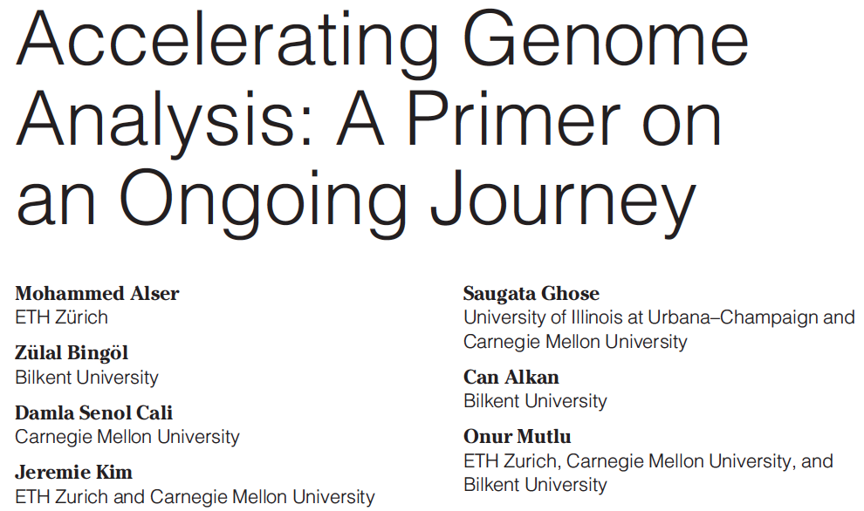
Accelerating Genome Analysis [IEEE MICRO 2020]
Mohammed Alser, Zulal Bingol, Damla Senol Cali, Jeremie Kim, Saugata Ghose, Can Alkan, and Onur Mutlu, "Accelerating Genome Analysis: A Primer on an Ongoing Journey" IEEE Micro (IEEE MICRO), Vol. 40, No. 5, pages 65-75, September/October 2020. [Slides (pptx)(pdf)] [Talk Video (1 hour 2 minutes)]
Notes:
In our group, we are also looking at in memory computation of genome analysis where you can make the computation where the data resides rather than moving the data between main memory and processing units.
This provides us the opportunity of not paying the cost of moving the data, significantly improving the performance especially when the memory movement is the bottleneck for a certain application.
You can read this paper to learn more on the challenges of designing hardware accelerations for genome analysis.

Slide 23
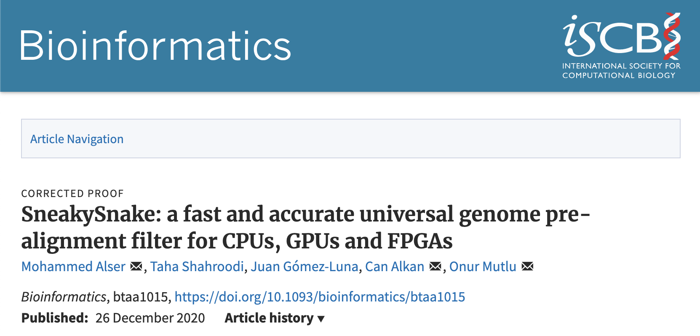
Specialized Hardware for Pre-alignment Filtering
Mohammed Alser, Taha Shahroodi, Juan-Gomez Luna, Can Alkan, and Onur Mutlu, "SneakySnake: A Fast and Accurate Universal Genome Pre-Alignment Filter for CPUs, GPUs, and FPGAs" Bioinformatics, 2020. [Source Code] [Online link at Bioinformatics Journal]
Notes:
To achieve accelerated read mapping on hardware, we have published several works. For example, SneakySnake can use CPUs, GPUs and FPGAs to quickly compute whether a sequence pair is sufficiently similar to each other given an edit distance threshold. Doing so, we can avoid performing the costly sequence alignment operations for sequence pairs that are unlikely to align.

Slide 24
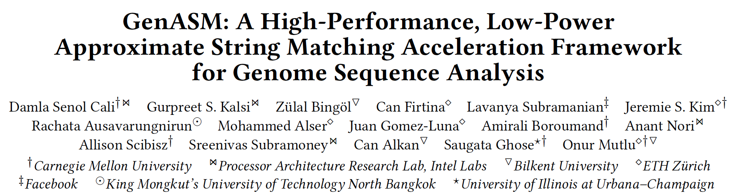
GenASM Framework [MICRO 2020]
Damla Senol Cali, Gurpreet S. Kalsi, Zulal Bingol, Can Firtina, Lavanya Subramanian, Jeremie S. Kim, Rachata Ausavarungnirun, Mohammed Alser, Juan Gomez-Luna, Amirali Boroumand, Anant Nori, Allison Scibisz, Sreenivas Subramoney, Can Alkan, Saugata Ghose, and Onur Mutlu, "GenASM: A High-Performance, Low-Power Approximate String Matching Acceleration Framework for Genome Sequence Analysis" Proceedings of the 53rd International Symposium on Microarchitecture (MICRO), Virtual, October 2020. [Lighting Talk Video (1.5 minutes)] [Lightning Talk Slides (pptx) (pdf)] [Talk Video (18 minutes)] [Slides (pptx) (pdf)]
Notes:
We are also looking into hardware-software co-design solutions for genome analysis. GenASM is one example of such a work where we provide a framework for accelerating approximate string matching. GenASM uses fast and simple bitwise operations to perform approximate string matching on a specialized hardware. It provides significant speedups while also reducing the power consumption compared to the state-of-the-art software and hardware accelerators

Slide 25
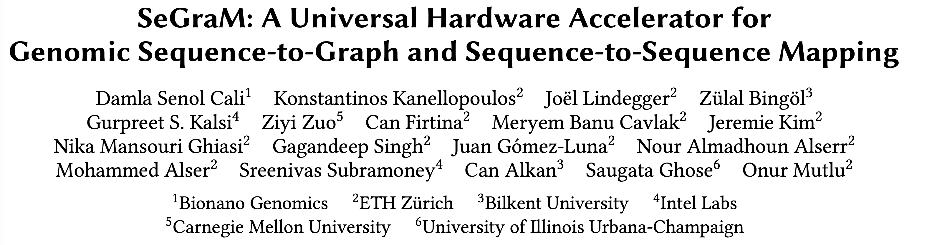
New Applications: Genome Graphs
Coming Up at ISCA 2022

Slide 26
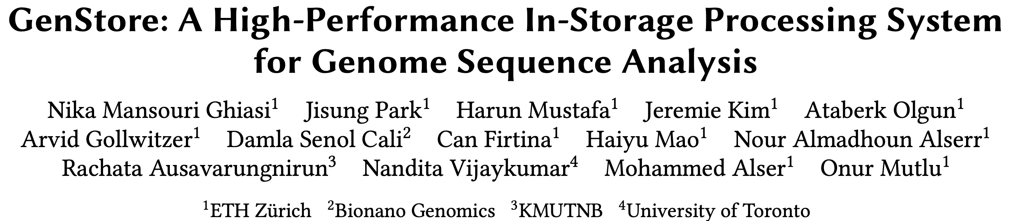
In-Storage Genome Filtering [ASPLOS 2022]
Nika Mansouri Ghiasi, Jisung Park, Harun Mustafa, Jeremie Kim, Ataberk Olgun, Arvid Gollwitzer, Damla Senol Cali, Can Firtina, Haiyu Mao, Nour Almadhoun Alserr, Rachata Ausavarungnirun, Nandita Vijaykumar, Mohammed Alser, and Onur Mutlu, "GenStore: A High-Performance and Energy-Efficient In-Storage Computing System for Genome Sequence Analysis" Proceedings of the 27th International Conference on Architectural Support for Programming Languages and Operating Systems (ASPLOS), Virtual, February-March 2022. [Lightning Talk Slides (pptx) (pdf)] [Lightning Talk Video (90 seconds)]

Slide 27
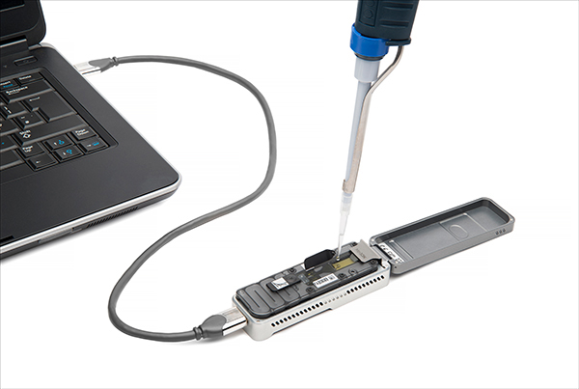
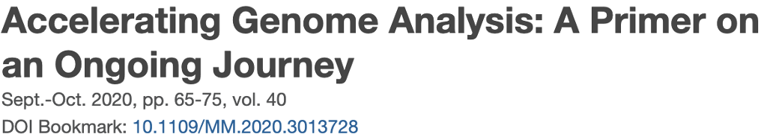
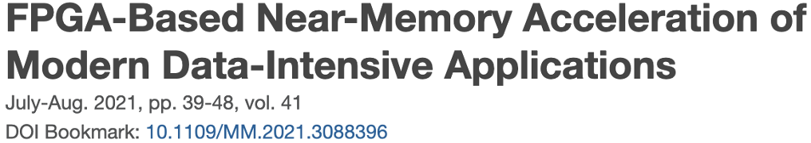
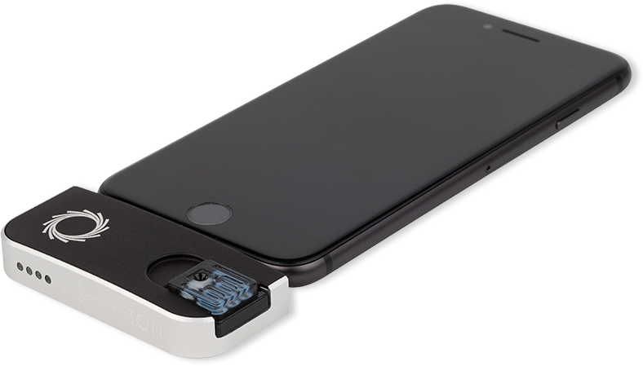
Future of Genome Sequencing & Analysis
Mohammed Alser, Zülal Bingöl, Damla Senol Cali, Jeremie Kim, Saugata Ghose, Can Alkan, Onur Mutlu
“Accelerating Genome Analysis: A Primer on an Ongoing Journey” IEEE Micro, August 2020.
MinION from ONT
SmidgION from ONT
Notes:
You can check these papers if you are interested in learning more about the challenges on both the software side of genome analysis and also adopting the hardware-accelerated genomic data analysis.
We believe that the future is going to be more focused on genome analysis with the growing amount of genomic data and it is important for processing devices to be lower power and high performant when analyzing genomic data for fast analysis

Slide 28
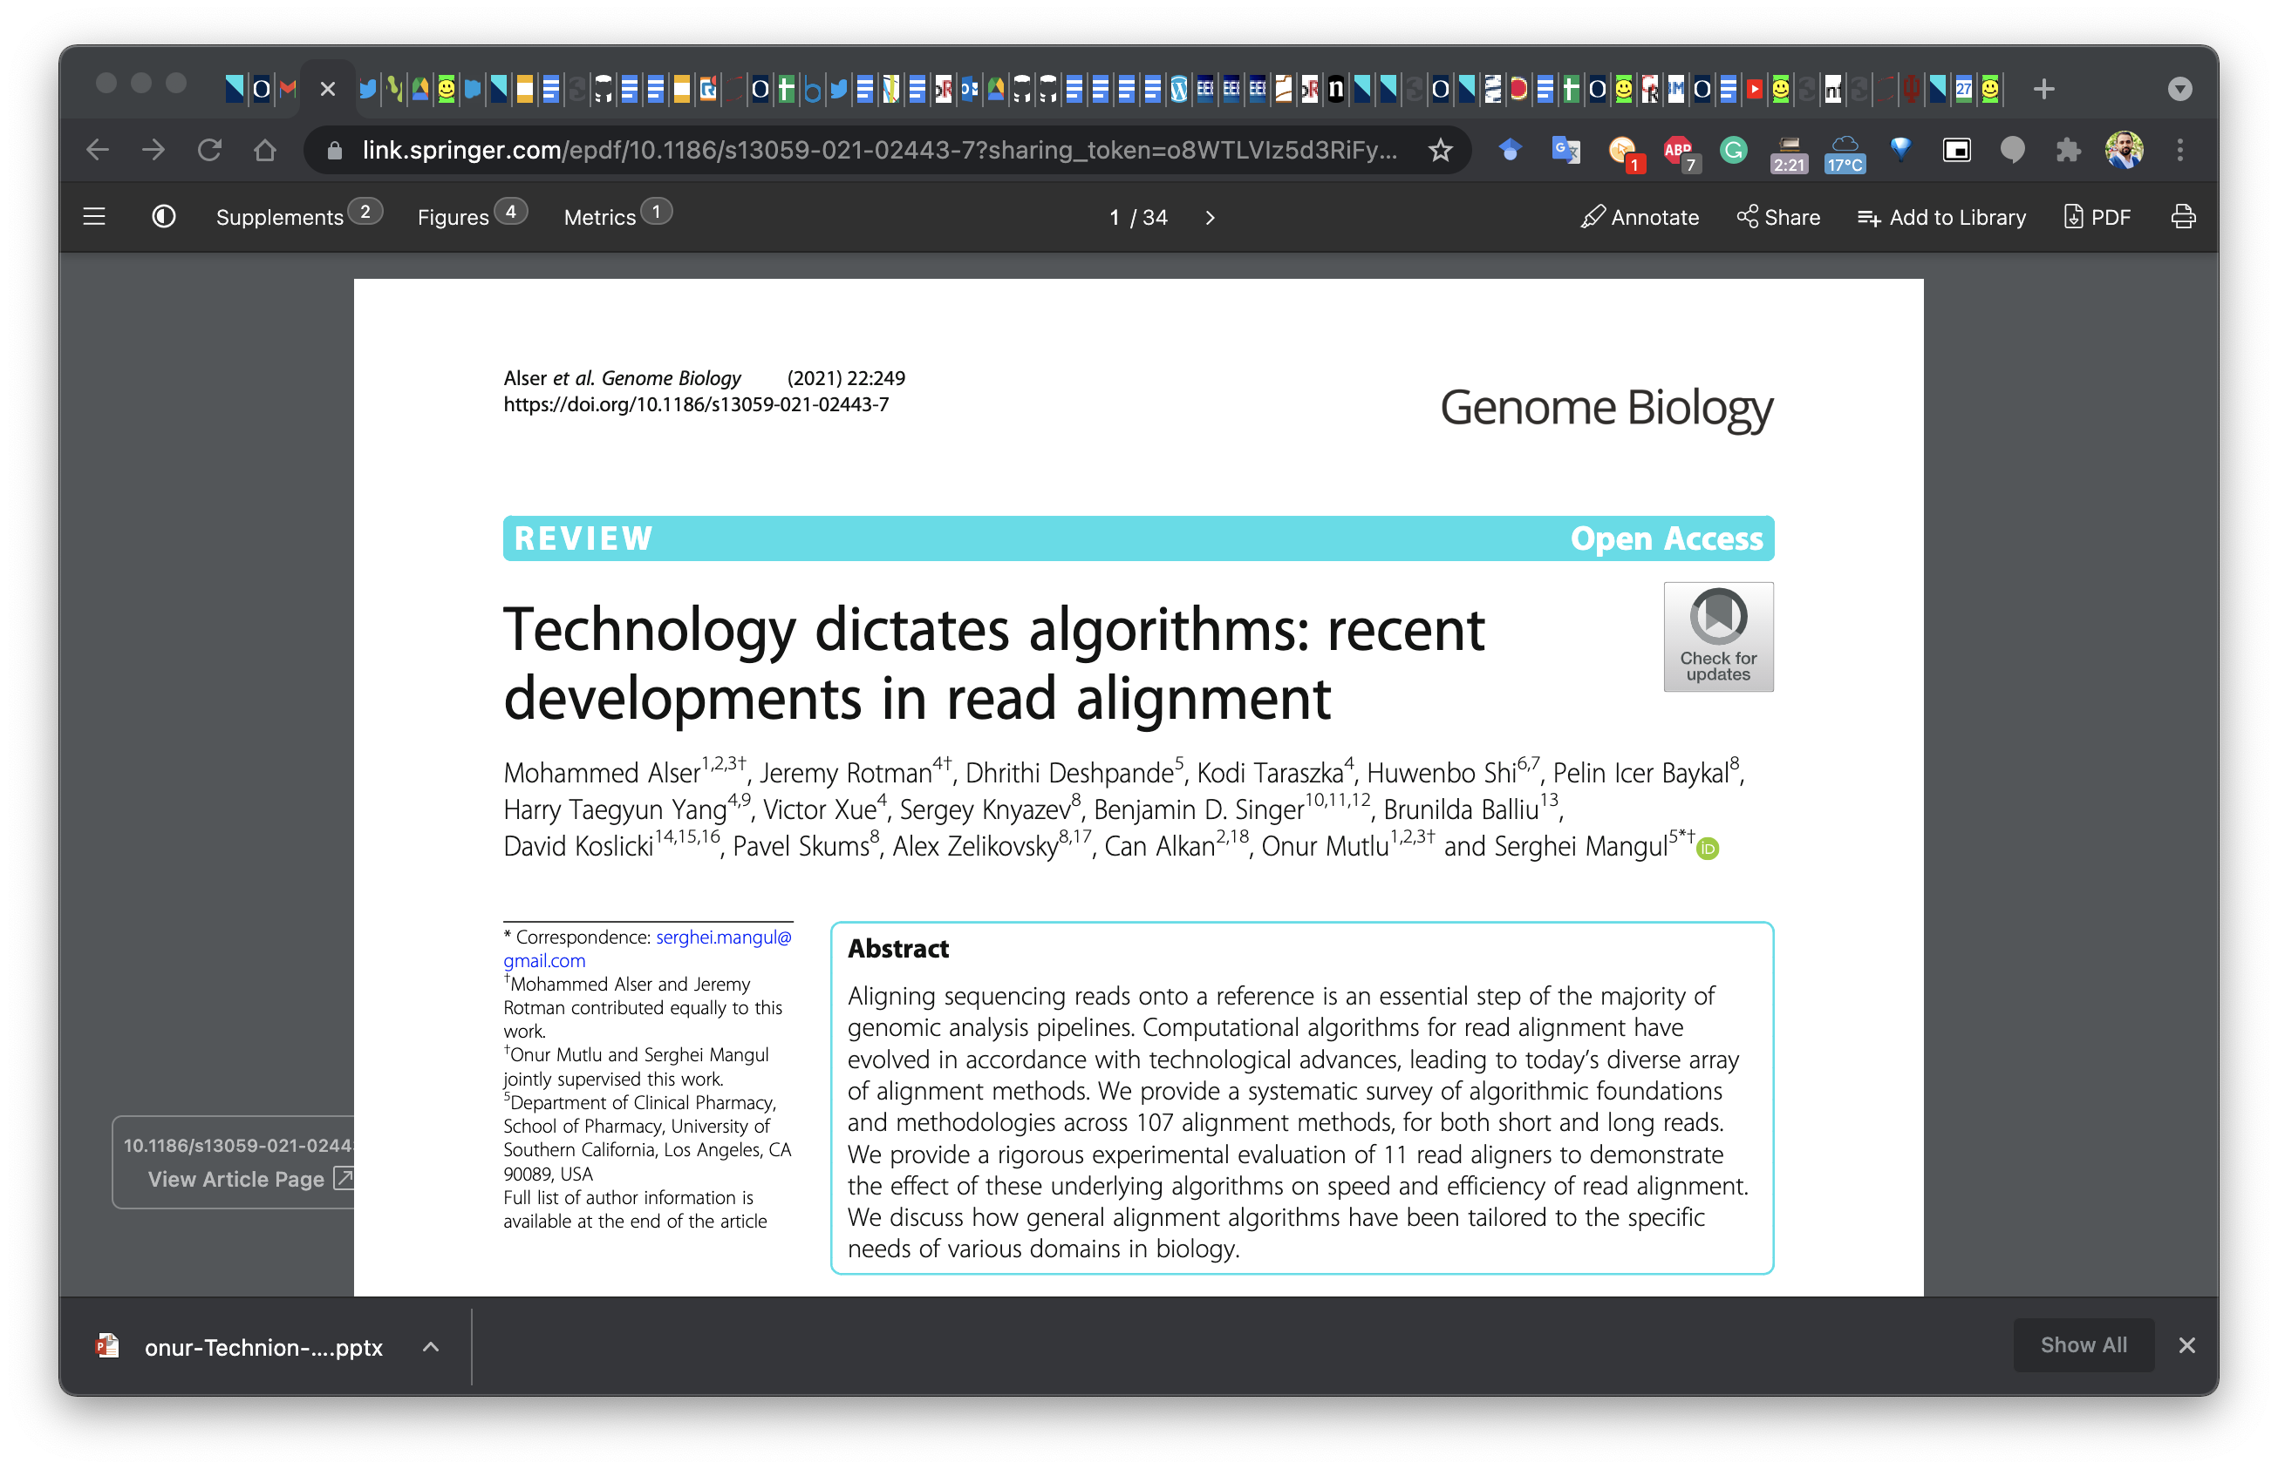
Read Mapping in 111 pages!
In-depth analysis of 107 read mappers (1988-2020)
Mohammed Alser, Jeremy Rotman, Dhrithi Deshpande, Kodi Taraszka, Huwenbo Shi, Pelin Icer Baykal, Harry Taegyun Yang, Victor Xue, Sergey Knyazev, Benjamin D. Singer, Brunilda Balliu, David Koslicki, Pavel Skums, Alex Zelikovsky, Can Alkan, Onur Mutlu, Serghei Mangul
"Technology dictates algorithms: Recent developments in read alignment"
Genome Biology, 2021
[Source code]
Notes:
This is a very comprehensive paper that surveys mainly all read mappers developed from 1988 to 2020 and explains the current trends and bottlenecks in read mapping going into the future

Slide 29
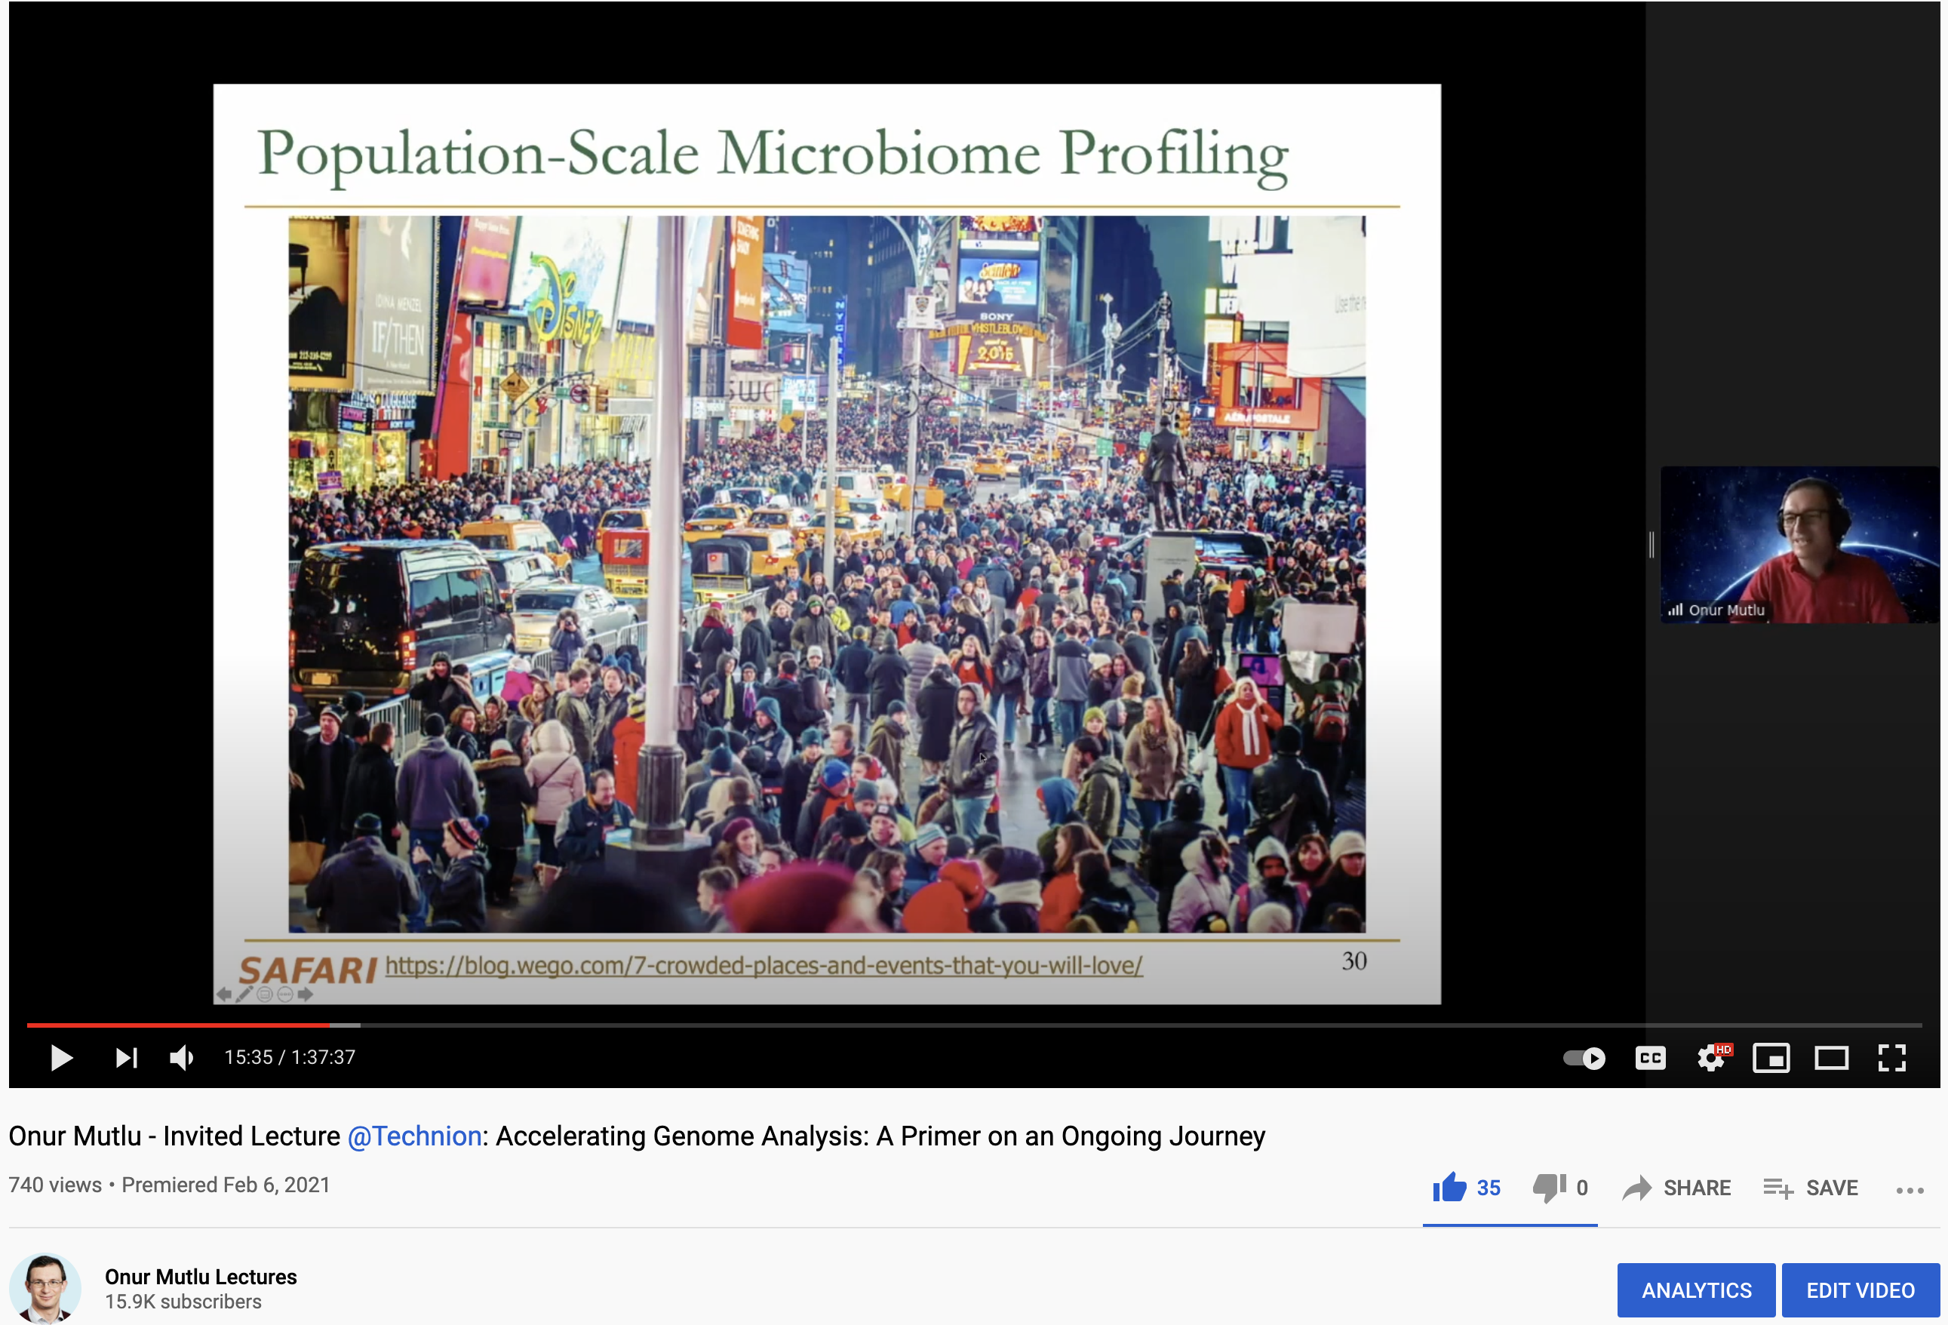
More on Fast & Efficient Genome Analysis …
Onur Mutlu, "Accelerating Genome Analysis: A Primer on an Ongoing Journey" Invited Lecture at Technion, Virtual, 26 January 2021. [Slides (pptx) (pdf)] [Talk Video (1 hour 37 minutes, including Q&A)] [Related Invited Paper (at IEEE Micro, 2020)]
https://www.youtube.com/watch?v=r7sn41lH-4A
Notes:
This is also a lecture that I can point you to

Slide 30
Detailed Lectures on Genome Analysis
Computer Architecture, Fall 2020, Lecture 3a
Introduction to Genome Sequence Analysis (ETH Zürich, Fall 2020)
https://www.youtube.com/watch?v=CrRb32v7SJc&list=PL5Q2soXY2Zi9xidyIgBxUz7xRPS-wisBN&index=5
Computer Architecture, Fall 2020, Lecture 8
Intelligent Genome Analysis (ETH Zürich, Fall 2020)
https://www.youtube.com/watch?v=ygmQpdDTL7o&list=PL5Q2soXY2Zi9xidyIgBxUz7xRPS-wisBN&index=14
Computer Architecture, Fall 2020, Lecture 9a
GenASM: Approx. String Matching Accelerator (ETH Zürich, Fall 2020)
https://www.youtube.com/watch?v=XoLpzmN-Pas&list=PL5Q2soXY2Zi9xidyIgBxUz7xRPS-wisBN&index=15
Accelerating Genomics Project Course, Fall 2020, Lecture 1
Accelerating Genomics (ETH Zürich, Fall 2020)
https://www.youtube.com/watch?v=rgjl8ZyLsAg&list=PL5Q2soXY2Zi9E2bBVAgCqLgwiDRQDTyId
https://www.youtube.com/onurmutlulectures
Notes:
Or you can check these lectures if you are interested in learning more about our journey on accelerating genome analysis

Slide 31
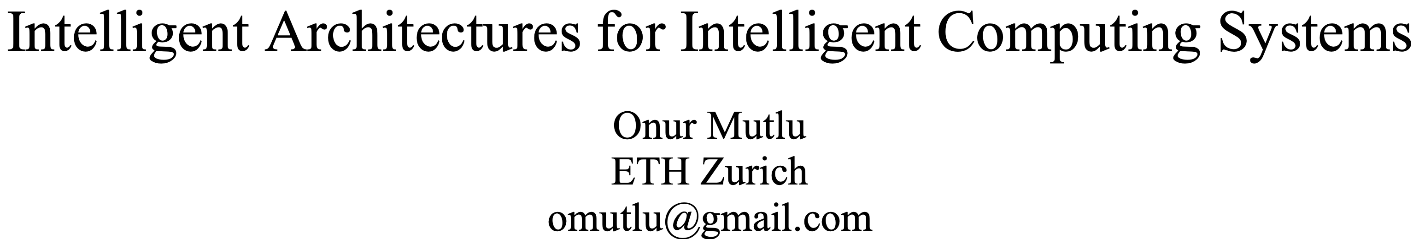
A Blueprint for Fundamentally Better Architectures
Onur Mutlu, "Intelligent Architectures for Intelligent Computing Systems" Invited Paper in Proceedings of the Design, Automation, and Test in Europe Conference (DATE), Virtual, February 2021. [Slides (pptx) (pdf)] [IEDM Tutorial Slides (pptx) (pdf)] [Short DATE Talk Video (11 minutes)] [Longer IEDM Tutorial Video (1 hr 51 minutes)]
Notes:
In general, emerging technologies can play a pivotal role for solving important problems. If you are interested in learning more about these emerging technologies, I am happy to point to these papers also.

Slide 32
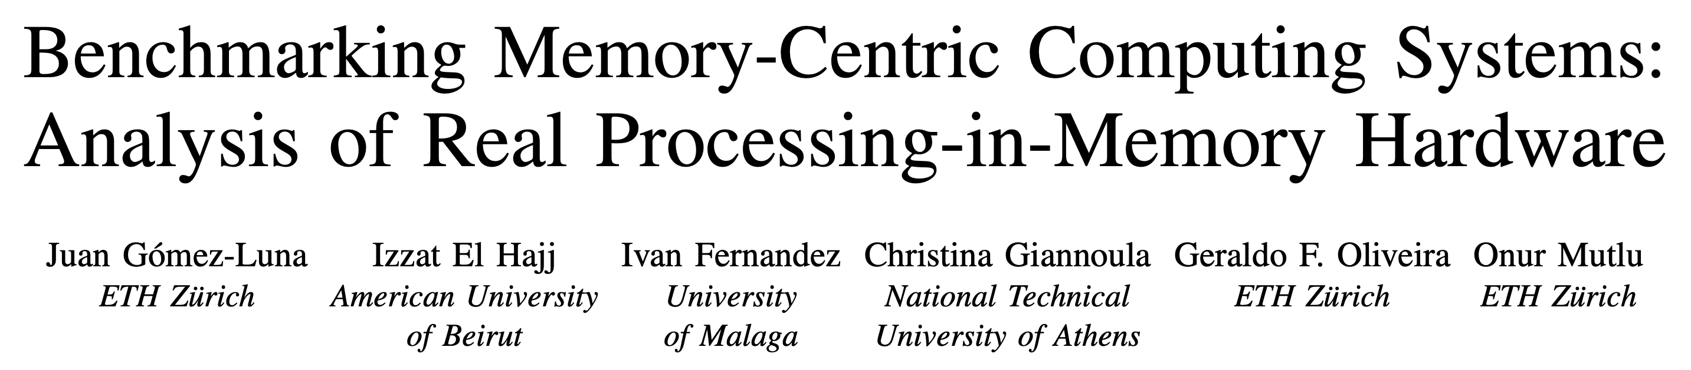
Analysis of first publicly available PIM Architecture
Juan Gomez-Luna, Izzat El Hajj, Ivan Fernandez, Christina Giannoula, Geraldo F. Oliveira, and Onur Mutlu, "Benchmarking Memory-Centric Computing Systems: Analysis of Real Processing-in-Memory Hardware" Invited Paper at Workshop on Computing with Unconventional Technologies (CUT), Virtual, October 2021. [arXiv version] [PrIM Benchmarks Source Code] [Slides (pptx) (pdf)] [Talk Video (37 minutes)] [Lightning Talk Video (3 minutes)]
Notes:
This is the first analysis of the first publicly available processing-in-memory arhitecture

Slide 33
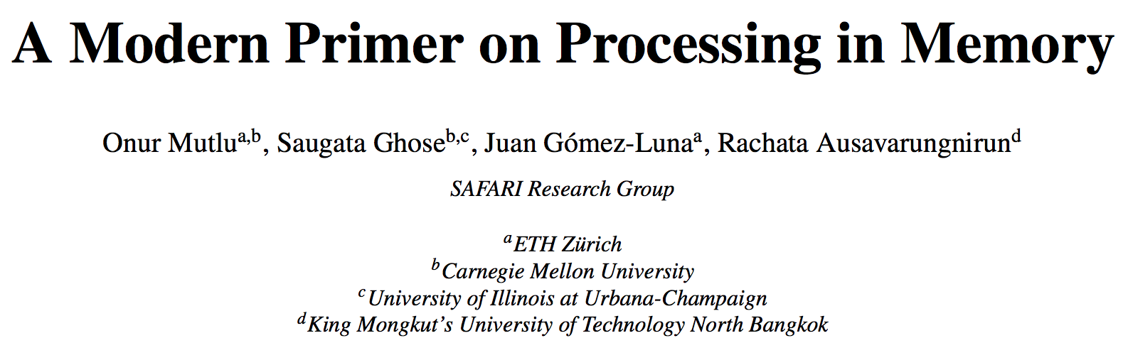
More on Processing in Memory
Onur Mutlu, Saugata Ghose, Juan Gomez-Luna, and Rachata Ausavarungnirun, "A Modern Primer on Processing in Memory" Invited Book Chapter in Emerging Computing: From Devices to Systems - Looking Beyond Moore and Von Neumann, Springer, to be published in 2021.
https://arxiv.org/pdf/1903.03988.pdf
Notes:
And more on processing in memory and

Slide 34
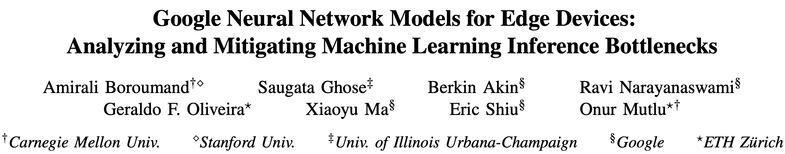
Accelerating Neural Network Inference
Amirali Boroumand, Saugata Ghose, Berkin Akin, Ravi Narayanaswami, Geraldo F. Oliveira, Xiaoyu Ma, Eric Shiu, and Onur Mutlu, "Google Neural Network Models for Edge Devices: Analyzing and Mitigating Machine Learning Inference Bottlenecks" Proceedings of the 30th International Conference on Parallel Architectures and Compilation Techniques (PACT), Virtual, September 2021. [Slides (pptx) (pdf)] [Talk Video (14 minutes)]
Notes:
Accelerating important applications

Slide 35
We need intelligent algorithms and intelligent architectures
that handle data well
Notes:
Clearly we need both intelligent algorithms and intelligent architectures to solve the important problems in our field. We’ve covered some on what can be done in the architecture side. We believe that we should co-design intelligent architecture and the intelligent software together to maximize the benefits.

Slide 36
Agenda for Today - Intelligent Algorithms
BLEND
Finding approximate (fuzzy) seed matches with a single lookup
AirLift
Avoiding redundant computations when moving from one reference genome to another
Apollo & ApHMM
Error correction using profile Hidden Markov Models (pHMMs) and accelerating pHMMs
Notes:
I will now talk more on the works we do mainly on the software side. I will cover four important works we have made publicly available recently.

Slide 37
Agenda for Today - Intelligent Algorithms
BLEND
Finding approximate (fuzzy) seed matches with a single lookup
AirLift
Avoiding redundant computations when moving from one reference genome to another
Apollo & ApHMM
Error correction using profile Hidden Markov Models (pHMMs) and accelerating pHMMs
Notes:
First one is BLEND

Slide 38
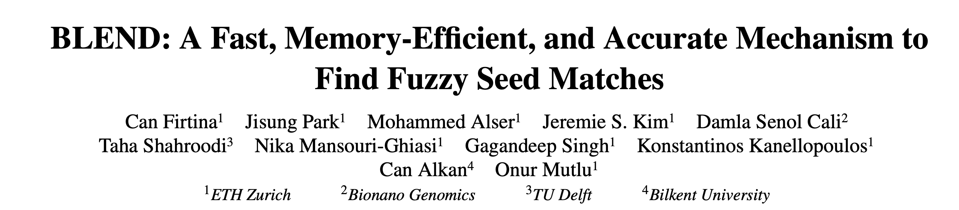
Finding Approximate Seed Matches
Can Firtina, Jisung Park, Mohammed Alser, Jeremie S. Kim, Damla Senol Cali, Taha Shahroodi, Nika Mansouri-Ghiasi, Gagandeep Singh, Konstantinos Kanellopoulos, Can Alkan, and Onur Mutlu, "BLEND: A Fast, Memory-Efficient, and Accurate Mechanism to Find Fuzzy Seed Matches" Preprint in arXiv, December 2021. [arXiv preprint] [BLEND Source Code and Data]
Notes:
BLEND is a mechanism for quickly finding approximate seed matches between sequences so that we can identify sequence similarity accurately and quickly. It is available in arXiv. You can also find the source code of BLEND in the GitHub page of our group.

Slide 39
Background – Seeds
Goal: Quickly identify matching subsequences between genomic sequence pairs
Seed
Sequence #1:
Sequence #2:
GCTATTACCTTAATGTGATGGAC
AGGCTATAACCCTAATGT
Hash Function
0x01
0xA4
0x41
0x01
0xFE
Store
Store
Store
Query
Query
Match
0x01
0xA4
0x41
No Match
Hash Table

Slide 40
Background – Matching Seeds
Hash tables enable finding seed matches with a single lookup of hash values
Finds exact-matching seeds based on their hash values
There are many seeding techniques
Minimizers: Sample k-mers based on their hash values
Spaced seeds: Ignore characters at certain positions of k-mers to tolerate substitutions between seeds
Linked k-mers (e.g., strobemers): Ignore gaps between sampled k-mers to tolerate both indels and substitutions

Slide 41
Problem
All of the seeding approaches use hash functions with low collision rates
Seeds must exactly match to find seed matches using their hash values
Dissimilar seeds have different hash values
Highly similar seeds have different hash values
The length and number of seed matches ➞ sensitivity, performance, and memory footprint
Exact-matching requirements introduce challenges for determining these parameters
Existing attempts optimizing seed matches suffer from either
Increasing the use of the costly sequence alignment step due to many seed matches
Limited sensitivity when finding seed matches

Slide 42
Goal
Enable finding fuzzy (i.e., approximate) matches of seeds with a single lookup of hash values of these seeds
Provide a mechanism for any seeding technique to generate the same hash values for highly similar seeds
To this end, we propose BLEND, a fast, memory-efficient, and accurate mechanism that can find fuzzy seed matches

Slide 43
Key Ideas
Exploit the key characteristics of the SimHash technique
Same hash value for highly similar seeds without imposing exact matches of seeds
Fuzzy seed matches with a single lookup while providing window guarantees for minimizers
Increased the collision rate for similar seeds while preserving the low collision rate for dissimilar seeds
A mechanism for converting seeds into sets of k-mers to use these sets with the SimHash technique

Slide 44
The SimHash Technique
Used for detecting near-duplicates mainly for web crawling by Google
Insight: Two sets are similar if their content is highly similar
Goal: Use the insight to enable generating the same hash value for highly similar sets
Input: Hash values of a set of items (e.g., words in a sentence)
Output: A hash value for the entire set (e.g., hash value of the sentence)

Slide 45
The SimHash Technique - Example
Input set: A sentence
Items: Words
This is an example sentence to generate a hash value with SimHash
Word Hash Value
This 0b01110100
is 0b11011101
an 0b00011100
example 0b01000001
Word Hash Value
sentence 0b11110000
to 0b01111101
generate 0b10011100
a 0b11000001
Word Hash Value
hash 0b11111101
value 0b00100001
with 0b01010101
SimHash 0b11001110
Bitwise Weighted Sum (Weight = -1 if bit 0, 1 if bit 1)
0, 6, -2, 4, 0, 4, -10, 2
0b01010101

Slide 46
High-Level Overview of BLEND
We find fuzzy seed matches between two sets of sequences
Target sequences (e.g., a reference genome)
Query sequences (e.g., read sequences)
BLEND can generate the same hash value for highly similar seeds

Slide 47
Walkthrough – Generating Hash Values
Input set: A seed
Items: Selected substrings (k-mers) of the seed
Goal: Generate the hash value of the seed using the SimHash technique
Hash Table

Slide 48
Walkthrough – Selecting k-mers from Seeds
BLEND-I
Include all overlapping k-mers of a seed in the set for hashing
More sensitive to substitutions

Slide 49
Walkthrough – Selecting k-mers from Seeds
BLEND-S
Find minimizers using regular hash functions
Link every n consecutive minimizers to generate a seed
Include all linked k-mers in the set for hashing
Higher tolerance for indels and substitutions

Slide 50
Finding Fuzzy Seed Matches
BLEND can generate the same hash value for highly similar seeds
Single lookup of hash values from hash table return both exact and fuzzy seed matches
Notes:
To find fuzzy seed matches between target and query sequences, we follow the similar steps as explained in the previous slides for generating the hash values of seeds of query sequences.
We, then, query the hash table BLEND generates for a target sequence with the hash values of seeds of query sequences.
If we can find the same hash value in the hash table, we find a fuzzy seed match between a target and query sequence because BLEND can assign the same hash value for similar needs as well as the exact-matching seeds.
Doing so we can efficiently find fuzzy seed matches unlike the existing works that calculate similarity between seeds to find fuzzy seed matches. This is because the existing work uses many k-mers in a vector for a seed and compares the vectors to each other, which is much costly in terms of computation and space than simply checking the existence of a hash value in a hash table.

Slide 51
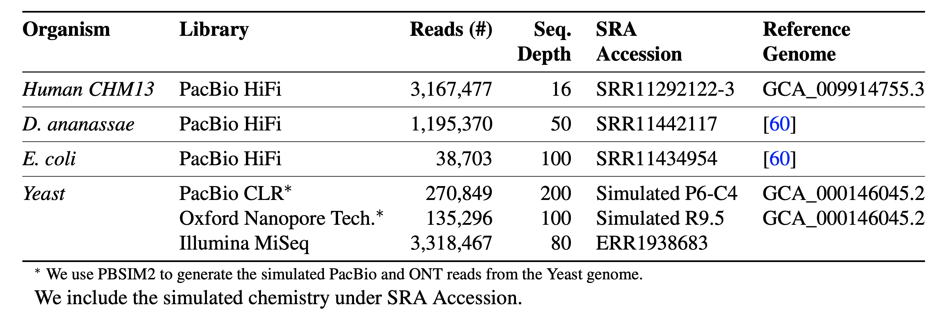
Evaluation Methodology
We integrate the BLEND mechanism into Minimap2
Real and simulated datasets
Use Cases
Read overlapping
Read mapping
Notes:
To evaluate our mechanism, we integrate BLEND into Minimap2 so that Minimap2 can find fuzzy seed matches for two important applications: finding overlapping reads and read mapping.
We use both real and simulated datasets from different genomes such as human genome, fruit fly, and e. coli genomes. We evaluate BLEND using both long and paired-end short reads.
We have tested BLEND on two use cases: read overlapping and read mapping. I will now show the results on finding overlapping reads and you can find more results in the paper.

Slide 52
Read Overlapping – Computational Resources
Significant improvements in terms of both performance and memory
Speedup by 2.6×-63.5× (on average 19.5×) and 22.2×-6317.1× (on average 1386.8×)
Reducing the memory footprint by 0.9×-9.7× (on average 3.6×) and 35.9×-238.1× (on average 130.5×) compared to minimap2 and MHAP, respectively

Slide 53
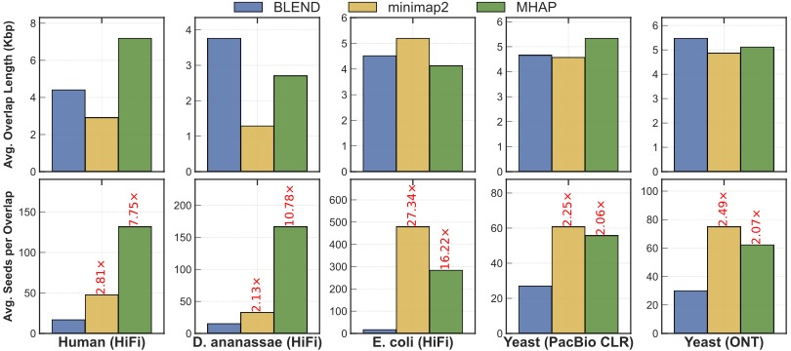
Read Overlapping – Overlap Statistics
BLEND finds overlaps longer than minimap2 and MHAP can find in most cases
BLEND uses significantly fewer seed matches than other tools by up to 27.34× to find these longer overlaps.

Slide 54
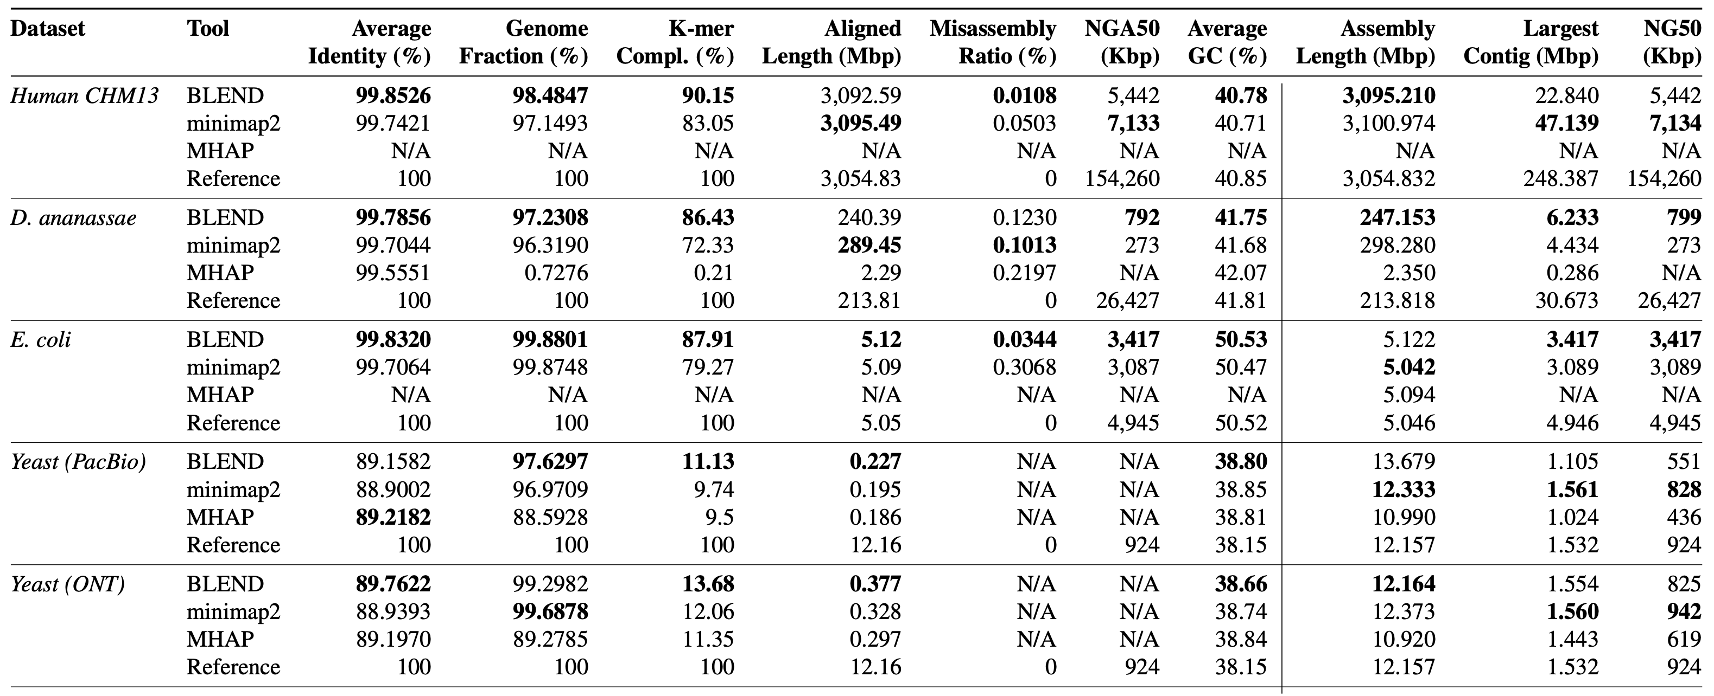
Read Overlapping – Accuracy
More accurate de novo assemblies in most cases
Contiguity results are similar to minimap2

Slide 55
Read Mapping – Computational Resources
Speedup by, on average, 1.7×, 12.5×, 7.5×, and 21.8× compared to minimap2, LRA, Winnowmap2, and S-conLSH, respectively.
Slightly more memory overhead than minimap2 and LRA (on average 0.9× and 0.8×), and lower than Winnowmap2 and S-conLSH (on average by 1.7× and 1.9×).

Slide 56
More from the paper…
Read mapping accuracy of BLEND is similar to minimap2
Winnowmap2 generates the most accurate read mapping
When the same parameters are used (e.g., window length)
Minimap2 also provides significant improvements in terms of performance and memory footprint (similar to BLEND) but with the cost of accuracy
This is because BLEND can find more seed matches (exact and approximate matches) than minimap2
BLEND-S is preferred for HiFi data whereas BLEND-I is more suitable for erroneous reads

Slide 57
Conclusion
BLEND can find fuzzy seed matches with a single lookup to improve the performance, memory efficiency, and accuracy
Efficient fuzzy seed matches provide higher sensitivity and extra room for adjusting the parameters designed for exact-matching seeds
Significant speedups and lower memory footprint especially when using HiFi reads
We can increase the window length without reducing the accuracy thanks to finding unique fuzzy seed matches that minimap2 cannot find
BLEND finds longer overlaps while using fewer seed matches to find these overlaps

Slide 58
Executive Summary
Problem: Existing attempts optimizing seed matches suffer from either
Increasing the use of the costly sequence alignment step due to many seed matches
Limited sensitivity when finding seed matches
Goal: Enable finding fuzzy (i.e., approximate) seed matches with a single lookup
Key Ideas:
Generate the same hash value for highly similar seeds using the SimHash technique
Provide mechanisms to convert seeds into sets of items for SimHash
Use hash tables to find fuzzy seed matches with a single lookup
Key Results
For read overlapping, significant improvements in terms of both performance and memory
We can construct more accurate assemblies using the overlaps that BLEND finds
For read mapping, performance improvements compared to all tools

Slide 59
Finding Approximate Seed Matches
Can Firtina, Jisung Park, Mohammed Alser, Jeremie S. Kim, Damla Senol Cali, Taha Shahroodi, Nika Mansouri-Ghiasi, Gagandeep Singh, Konstantinos Kanellopoulos, Can Alkan, and Onur Mutlu, "BLEND: A Fast, Memory-Efficient, and Accurate Mechanism to Find Fuzzy Seed Matches" Preprint in arXiv, December 2021. [arXiv preprint] [BLEND Source Code and Data]
Notes:
The preprint of BLEND is available in arXiv and we have made the source code available in GitHub. We will make these slides available so that you can find the links to all materials easily.

Slide 60
Agenda for Today - Intelligent Algorithms
BLEND
Finding approximate (fuzzy) seed matches with a single lookup
AirLift
Avoiding redundant computations when moving from one reference genome to another
Apollo & ApHMM
Error correction using profile Hidden Markov Models (pHMMs) and accelerating pHMMs
Notes:
I will now move to AirLift as the second item in our agenda today.

Slide 61
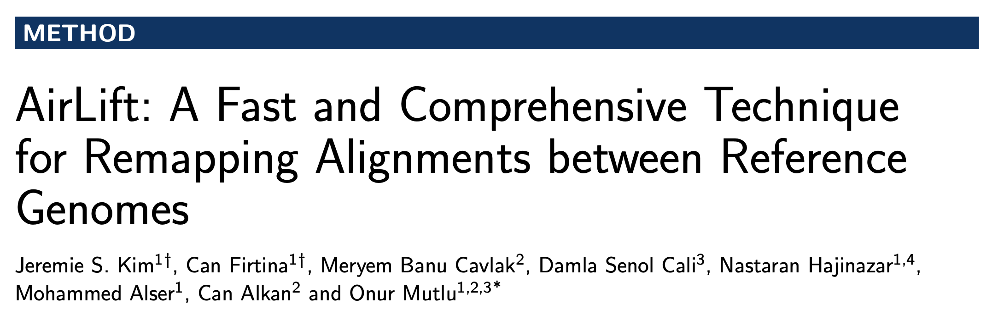
Remapping Alignments Between References
Jeremie S. Kim, Can Firtina, Meryem Banu Cavlak, Damla Senol Cali, Nastaran Hajinazar, Mohammed Alser, Can Alkan, and Onur Mutlu, "AirLift: A Fast and Comprehensive Technique for Remapping Alignments between Reference Genomes" Preprint in arXiv and bioRxiv, 17 February 2021. [bioRxiv preprint] [arXiv preprint] [AirLift Source Code and Data]
Notes:
AirLift is a mechanism for quickly moving read mapping annotations such as mapping locations from one reference genome to another. We usually do such updates in read mapping when, for example, a reference genome gets updated. AirLift is available in arXiv and bioRxiv and you can find the source code in our GitHub page.

Slide 62
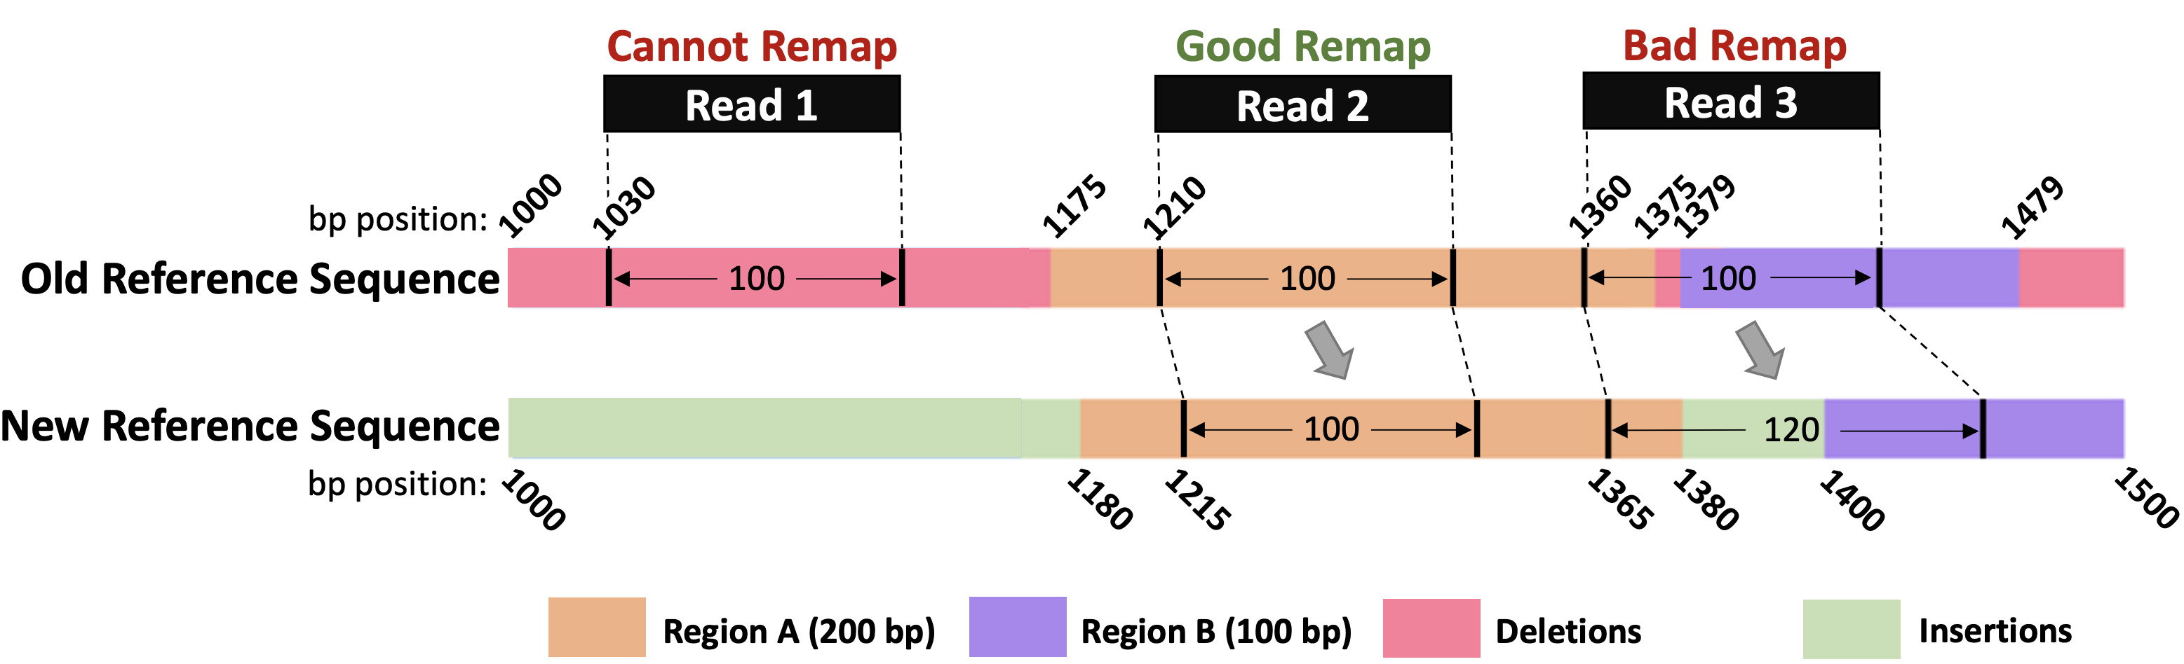
Background
Reference genomes are updated frequently (~quarterly)
Recent high quality reference genomes (CHM13-T2T)
For accurate annotations for an updated genome, all reads of a given sample are completely remapped to the new, updated reference genome
This becomes unreasonable with the number of sequenced genomes available now
Many existing works speed up this process by only moving annotations (e.g., read mapping positions) given known matching regions
Notes:
I will start with a brief background. We use reference genomes to map the reads to their corresponding genomes to do further downstream genome analysis based on read mapping. Refernce genomes usually have high quality in terms of the completeness of a genome. These genomes still get updated periodically such that they contain more useful and complete information.
[CLICK]
In order to get the best out of the new reference genomes, we may prefer remapping our reads again to the newest reference genome. However, this may be unreasonable to remap all existing read sets to their newest reference genomes as read mapping itself is already computationally costly.
[CLICK]
There are some works that quickly analyzes the common regions between the older reference genome and the newest one such that the reads that fall in these common regions can be moved without performing read mapping because we would potentially only need to update the positions of these mapping locations without updating sequence alignment-related information such as CIGAR string.
However these works can update only the common regions shown as good remap in the orange region in this figure.
If the region in the old reference genome is deleted or if there is a novel region in the new reference genome, these related works cannot move reads from or to these old and new regions.

Slide 63
Background (cont’d)
A number of tools exist for remapping annotations
To remap across samples of the same species or across very similar reference genomes
Tools:
UCSC Liftover
CrossMap
RECOT
Segment_liftover
NCBI Genome Remapping Service
Assembly Converter (Ensembl)
Galaxy (based on UCSC liftover)
Pyliftover
Generate chain files, which indicates similar blocks of regions across two genomes (via global alignment) and move annotations using the chain file
Notes:
There are many existing tools that move annotations in different file formats such as BED, SAM/BAM, VCF files etc.
[CLICK]
These tools take a file in a special format called the chain file. These chain files contain the list of sequence blocks that appear in both old and new reference genomes along with the location information on where they appear in both references.
Having a chain file for a pair of old and new reference genomes, we can easily move the positions of reads by checking where the sequence blocks that they map to appear in the new reference genome, if such a block exists. If not, we cannot move these reads easily using these existing tools.

Slide 64
Problem
Existing tools move annotations (e.g., read mapping positions) only when the same region appears in the new reference genome
Same regions between two reference genomes are identified using global alignment – chain files contain the aligning blocks
Simply moving annotations, based on a global alignment does not account for a large portion of genes
We find that from hg19 -> hg38, up to 7% of genes are missed (GENCODE)
Simply moving annotations is not accurate
as it loses a significant amount of information
Potentially important regions are lost
Notes:
To reitrate the problem, moving the annotations only based on a chain file which shows the near-exact-matching blocks between reference pairs does not account for a large portion of genes in the new reference genomes. For example, we find that up to 7% of genes are missing in the old reference genome compared to the newest major release of the human genome.
[CLICK]
Being able to map to these regions are crucial to perform crytical downstream analysis.
[CLICK]
Thus, simply moving annotations is not accurate and it loses a significant amount of information.

Slide 65
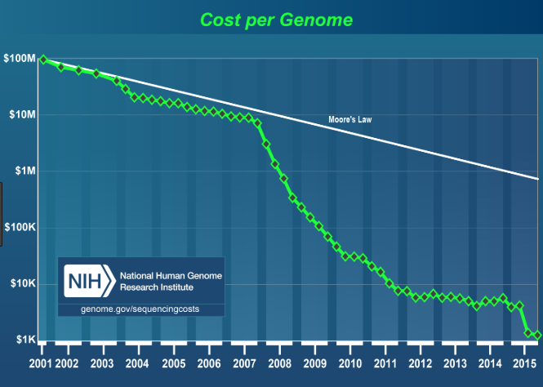
Problem (cont’d)
To reach baseline accuracy of completely read mapping reads to the new reference genome:
Could re-run read mapping to the entire new reference genome
This is expensive especially if we want to map every existing sequenced genome (>500,000 as of 2017) to every reference genome update (quarterly)
Notes:
We could potentially re-run read mapping of the full set of reads to the new reference genome.
[CLICK]
However, as discussed earlier, this is a costly step given that we generate more and more sequencing data than what we can process today.

Slide 66
Goal
Maintain baseline accuracy of mapping reads to an updated reference genome, while significantly accelerating the process
Baseline is using a full mapper
Enable quick and accurate mapping of every sample to every updated reference genome no matter how small the changes
This will quickly give us the most up to date information about a sample’s genome
Notes:
[CLICK quickly]
Our goal is to accelerate this moving step from old reference genome to the new reference genome by being both as accurate as fully mapping reads and second
[CLICK]
Enabling quick mapping to the new reference genome so that we can quickly generate the most up-to-date information using newer reference genomes.

Slide 67
Mechanism
We provide a method for quickly remapping all the reads of a sample from one reference genome to an updated version of the reference genome
Read mapping to old reference genome
(SAM/BAM file)
AirLift
Chain file + new reference genome
Updated read mapping to new reference genome
(SAM/BAM file)
Notes:
AirLift provides a method for quickly remapping all the reads from one reference genome to another.
It takes the read mapping to the old reference genome, as well as the chain file and new reference genome as inputs. It outputs the updated read mapping to the new reference genome.

Slide 68
Mechanism (cont’d)
We provide a method for quickly remapping all the reads of a sample from one reference genome to an updated version of the reference genome
Reads
Chain files provide the following relationship between two reference genomes
Notes:
We can quickly move the reads that fall in the regions shared across different versions of reference genomes.
Here for example the orange regions are shared so we can simply move the positions of reads that fall into these regions accordingly with respect to where they appear in the new reference genome.
[CLICK]
We can also move the reads [CLICK] to the novel regions that do not exist in the older reference genome.

Slide 69
Labeling Regions of Reference Genomes
We quickly label the regions between two reference genomes to decide if we should
Move the read mapping position without performing costly alignment or
Remap reads that maps in the regions that are missing in the new reference genome
Finding labels between a pair of reference genomes is a one-time task: AirLift Index
Labels: Constant, updated, retired, and new regions
Notes:
To achieve this, we first start with labeling the regions by comparing two reference genomes. Labeling helps us decide if we should simply move the reads without performing read mapping or we should perform read mapping for a read that falls into a region with a certain label.
[CLICK]
Finding labels between a pair of reference genomes is a one time task, which we call AirLift index. We can then use AirLift index many times when moving different sets of reads from the same old reference genome to the new reference genome. For example from hg19 to hg38.
[CLICK]
We call these labels as constant, updated, retired, and new regions as I will explain next.

Slide 70
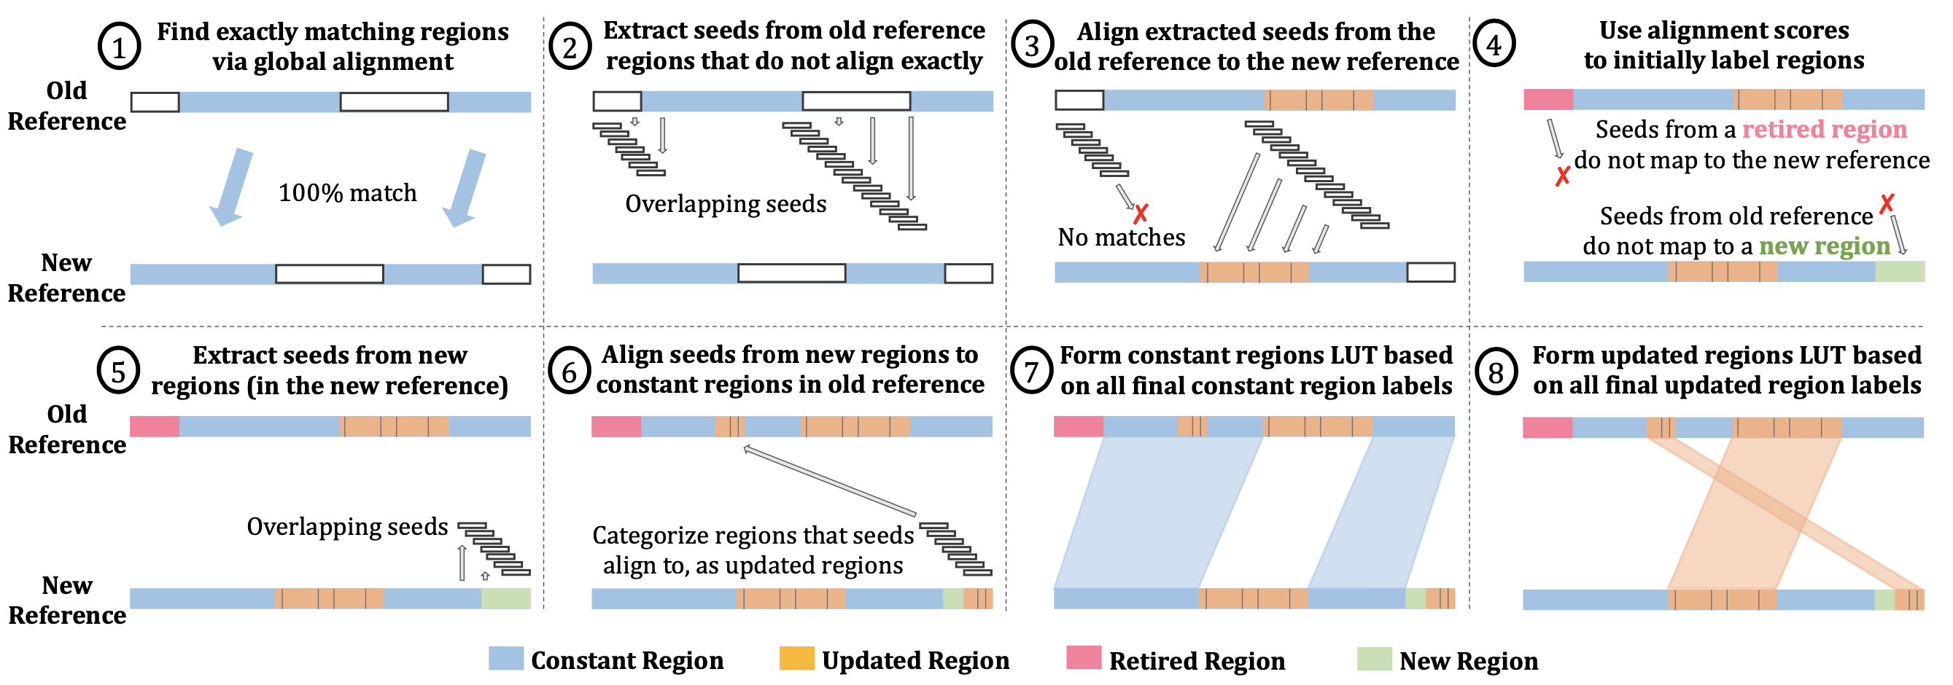
AirLift Index: Labeling Regions in 8 steps
Notes:
AirLift generates the labels between a pair of reference genomes mainly in 8 steps.
[CLICK]

Slide 71
AirLift Index: Labeling Regions in 8 steps
Notes:
We first start with finding the regions in the old reference genome that appear exactly the same in the new reference genome so that we can simply just move read mappings in these regions to their relative positions in the new reference genome without updating their CIGAR strings etc. We call these regions constant regions.
[CLICK]
For all other remaining parts in the old reference genome, we extract read-size overlapping sequences from these regions and map them to the new reference genome.
[CLICK]
We do this to identify the regions that no longer exist in the new reference genome called retired regions as well as the regions that are slightly updated in the new reference genome.
[CLICK]
Doing so, we also find the new regions in the new reference genome because they are found neither in the constant regions nor updated and retired regions.
[CLICK]
To identify if some of the constant regions in the old reference genome is potentially similar to the new regions in the new reference genome, we map the read-size overlapping sequences in the new regions to constant regions.
[CLICK]
The constant regions that are similar to new regions are also labeled as updated regions because the reads that fall in these constant regions can potentially align the new regions better.
[CLICK]
We then create a simple look up table (LUT) based on all constant region and
[CLICK]
Updated and retired region labels.
These look-up tables are created once and used many times when remapping many different sets of reads from old reference genome to newer reference genomes. We call these look-up tables AirLift index.

Slide 72
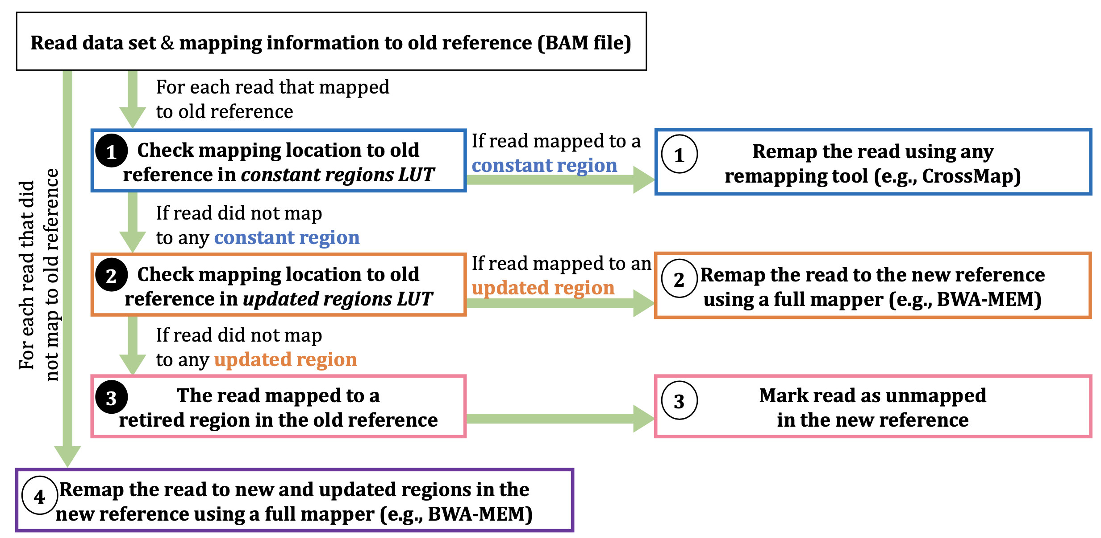
Updating Read Mapping using AirLift Index
Notes:
Then for a given BAM or SAM file that contains the read mapping information to a old reference genome, and the AirLift index, we can quickly find whether we should move the reads without alignment or we need to perform a sequence alignment for a certain read.
If a read is mapped to the constant region, we can simply use any existing remapping tool to move the annotations using chain files from old reference genome to new reference genome. In our case, we use an existing remapping work called CrossMap to perform this computation. In fact, we have a new version of CrossMap that we accelerate significantly, which we will include in the new version of our preprint soon.
If a read maps to either retired or updated regions, we then combine all such reads by keeping their paired-end information and fully map them to the new reference genome. Since we extract reads from constant regions that are potentially similar to the new regions in the new reference genome, too, we provide a comprehensive extraction of reads that need to be fully mapped. Existing remapping tools would have simply moved these regions to their new regions in the new reference genome without checking if they better align to novel regions in the new reference genome.
We also map all the other reads that had not been mapped to the old reference genome.
Combining all these mapping information, we create a single BAM/SAM file that contains a comprehensive mapping of full read set to a new reference genome without computing sequence alignment redundantly.

Slide 73
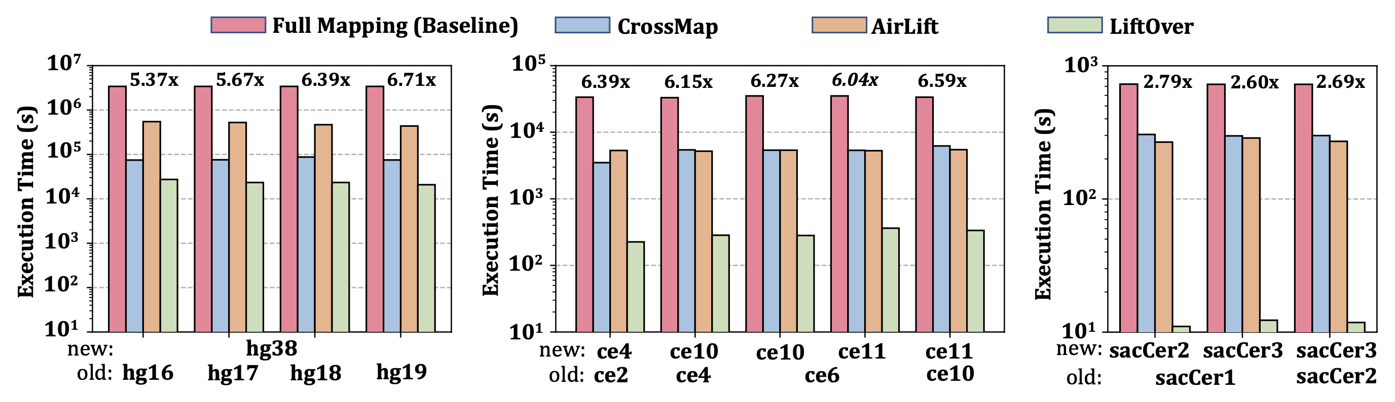
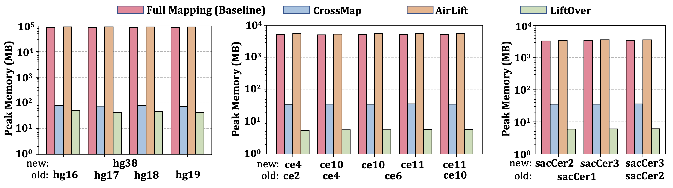
Key Results – Performance and Memory
AirLift is 2.6x-6.71x faster than full mapping while requiring similar peak memory usage
(KB)
(KB)
(KB)
Notes:
I will show two key results from our paper.
Here full mapping is our baseline where we map the complete set of reads to the new reference genome. CrossMap and LiftOver are state-of-the-art remapping tools that move the annotations from old reference genome to new one using chain files.
First we show that AirLift provides a significant speedup compared to fully mapping reads to new reference genome. AirLift is slower than CrossMap and LiftOver as these works only move the annotations without mapping the reads from updated and retired regions.
AirLift requires a peak memory usage similar to what full mapping requires.

Slide 74
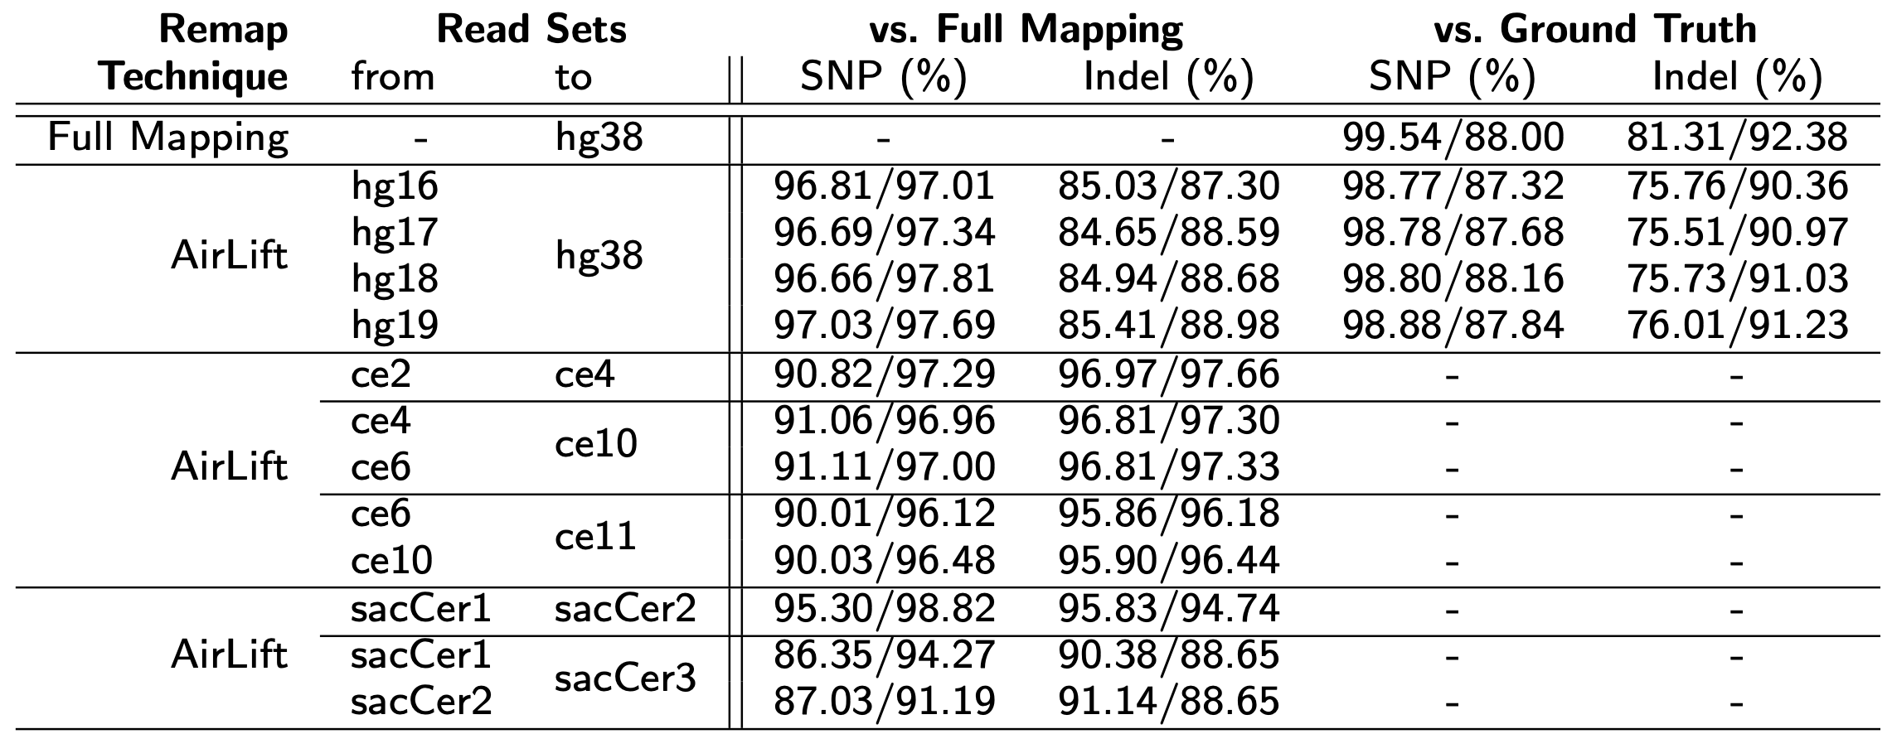
Key Results – Variant Calling
We use GATK to call the variants in read mappings that full mapping (to new reference genome) and AirLift generate
Variant calling ground truth from Platinum Genomes and GIAB for the human NA12878 sample
Variant calling accuracy is comparable to full mapping
Notes:
Second, we show that AirLift does not compromise from variant calling accuracy by being significantly faster than full mapping.
We perform variant calling using the BAM files we generate from full mapping and AirLift. We use GATK HaplotypeCaller to call the variants. Then we compare the variants we find using full mapping and AirLift to the ground truth, which is available only for the human genome dataset we use. The ground truth variant calling is derived from Genome in a Bottle and Platinum Genomes datasets from the ash kenazi trio sample (son)
When compared to ground truth, we find that precision and recall of AirLift is comparable to full mapping.
When we compare the variant calling of AirLift to Full Mapping, we find that the high portion of variants found by Full mapping is also found by AirLift for all other datasets.
We conclude that AirLift achieves a similar variant calling accuracy while being significantly faster than full mapping.

Slide 75
Executive Summary
Problem
Remapping full set of reads to newer reference genome is accurate, but computationally costly
Existing tools that move the annotations from one reference to another miss moving large portion of annotations to a new reference genome
Goal: Maintain baseline accuracy of remapping full set of reads, while significantly accelerating the process of moving from one reference to another
Key Ideas:
Categorize and label each region in the old reference genome compared to the new reference genome
Either 1) Remap a read to a new reference genome or 2) simply move its annotation based on the label of the region that the read falls into in the old reference genome
Results
2.6x – 6.7x speedup compared to fully mapping reads, while identifying SNPs and Indels with precision and recall similar to full mapping
Notes:
Let me then quickly go over the executive summary of AirLift.
When there is a new reference genome available, we can fully map the reads to the new reference genome. This is potentially the most accurate way to utilize the new reference genome but it is computationally costly. We can use existing tools that move the annotations without performing read mapping, but they mainly miss the large portion of the novel regions in the new reference genome.
[CLICK]
Our goal is to significantly accelerate the process of updating the read mapping annotations from one reference genome to another while maintaining baseline accuracy of remapping full set of reads
[CLICK]
To this end, we have two key ideas. AirLift first categorizes and labels each region in the old reference genome compared to the new reference genome.
Second, based on the categorizations of the regions, AirLift decides either to simply move the annotations using chain files as existing remapping works do, or map the reads to reference genome. These two key ideas allow us to both accelerate the remapping process and still be accurate as we also map the reads to the new reference genome.
[CLICK]
We show that AirLift provides 2.6x to 6.7x speedup compared to fully mapping reads while providing similar variant calling accuracy.

Slide 76
Remapping Alignments Between References
Jeremie S. Kim, Can Firtina, Meryem Banu Cavlak, Damla Senol Cali, Nastaran Hajinazar, Mohammed Alser, Can Alkan, and Onur Mutlu, "AirLift: A Fast and Comprehensive Technique for Remapping Alignments between Reference Genomes" Preprint in arXiv and bioRxiv, 17 February 2021. [bioRxiv preprint] [arXiv preprint] [AirLift Source Code and Data]
Notes:
You can read our preprint, which is likely to be updated soon, for more information on AirLift.

Slide 77
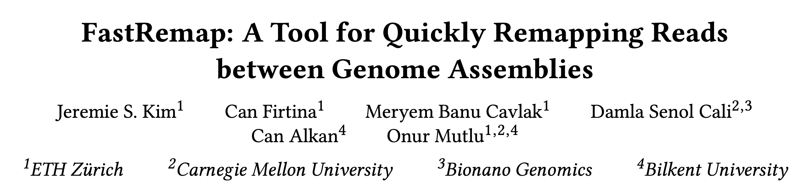
Mapping Constant Regions Between References
Jeremie S. Kim, Can Firtina, Meryem Banu Cavlak, Damla Senol Cali, Can Alkan, and Onur Mutlu, "FastRemap: A Tool for Quickly Remapping Reads between Genome Assemblies" Preprint in arXiv, 26 January 2022. [arXiv preprint] [FastRemap Source Code]
Notes:
You can read our preprint, which is likely to be updated soon, for more information on AirLift.

Slide 78
Agenda for Today - Intelligent Algorithms
BLEND
Finding approximate (fuzzy) seed matches with a single lookup
AirLift
Avoiding redundant computations when moving from one reference genome to another
Apollo & ApHMM
Error correction using profile Hidden Markov Models (pHMMs) and accelerating pHMMs
Notes:
I will now talk more on the works we do on the software side. I will cover three important works we have made publicly available recently.

Slide 79
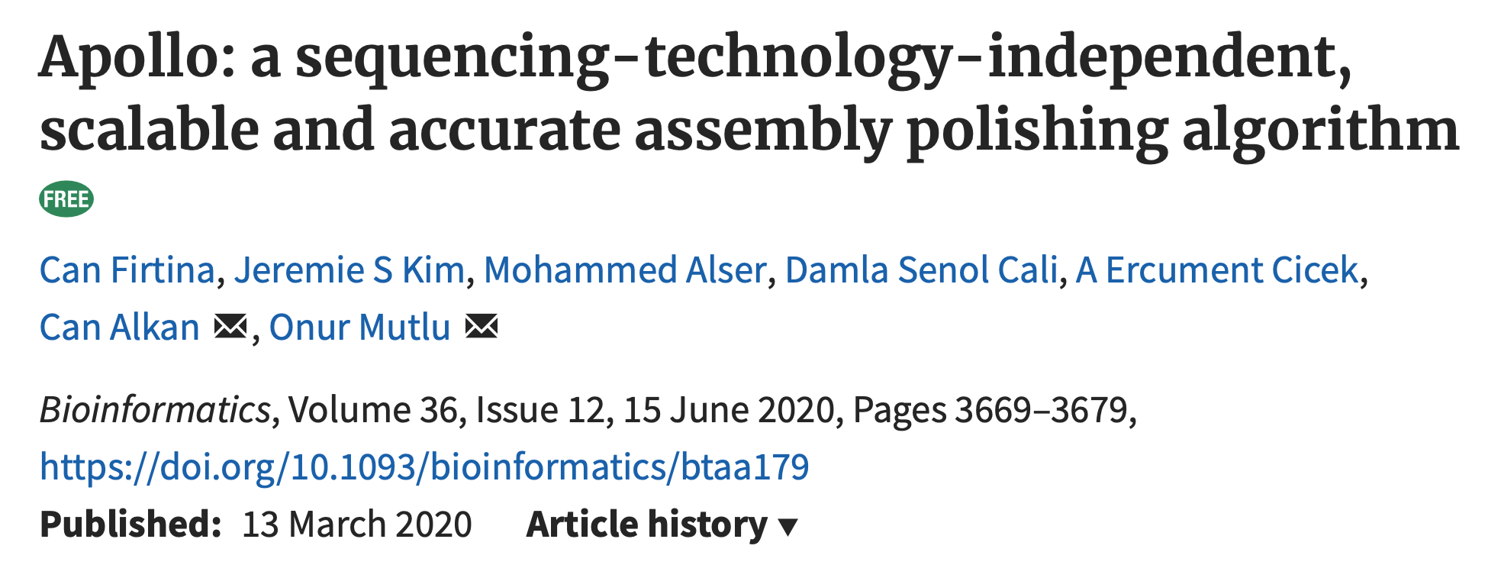
Assembly Polishing using ML
Can Firtina, Jeremie S. Kim, Mohammed Alser, Damla Senol Cali, A. Ercument Cicek, Can Alkan, and Onur Mutlu, "Apollo: A Sequencing-Technology-Independent, Scalable, and Accurate Assembly Polishing Algorithm" Bioinformatics, June 2020. [Source Code] [Online link at Bioinformatics Journal]
Notes:
Apollo is a mechanism for correcting errors in genome assemblies using a machine learning technique. It was published in the Bioinformatics journal in 2020.

Slide 80
Executive Summary
Problem:
Long read de novo assembly is inherently erroneous – needs error correction
Existing assembly error correction (polishing) techniques cannot adapt to varying sequencing technologies and do not scale well for large genomes
Goal: Propose a technology-independent, accurate, and scalable assembly polishing algorithm
Key Ideas:
Use a probabilistic graph structure to represent assemblies with potential errors
Profile hidden Markov models (pHMMs)
Update (train) the probabilities using read alignments to the assembly
Decode the trained pHMM to identify and correct the errors in the assembly
Results
Apollo is the only assembly polishing that is scalable to polish large genomes given the limited memory constraints (e.g., 192GB)
Apollo constructs the most accurate assemblies when reads from multiple technologies are used within a single run compared to other polishing tools
Apollo is ~25x slower on average (up to ~600x) than other polishers
Notes:
Let's start with the executive summary of the paper.
De-novo assemblies constructed using erroneous long reads potentially include the errors propagated from long reads. There are some assembly polishing tools that aim to correct (in other words: polish) these errors. However, these existing tools are not flexible to adapt to varying error profiles of different sequencing technologies and they have a high memory-footprint when polishing large genomes such as a human genome.
[CLICK]
Our goal is to propose a flexible and scalable assembly polishing algorithm. To this end, we propose Apollo.
[CLICK]
Apollo is mainly composed of two key ideas. First, we construct a special type of graph that is known as the profile hidden Markov model (pHMMs) for each assembly sequence. We use this pHMMs to represent the probabilistic model of the errors that may appear in an assembly.
Second, we re-align the same reads that are used to construct the assembly (and any other additional reads) to the pHMM graph. By doing so, we can use some machine learning techniques to update the probabilities in a graph that essentially helps us resolve the errors in assemblies.
[CLICK]
We show three key results. First, Apollo is the only polishing algorithm that can polish large genomes given the memory constraints used in our experiments (192GB). Second, Apollo constructs the most reliable assemblies when both long reads and Illumina reads from the same sample are available for polishing. Third, Apollo performs worse than most of the other polishing tools due to its computationally expensive training and inference steps.

Slide 81
De novo Assembly from Erroneous Reads
Genome
(Non-human-
readable)
Sequencing
Reads
(Human-
readable)
Overlap
Layout
Consensus
Sequencing Errors
Erroneous Assembly:
Notes:
So how do we generate de novo assemblies?
We generate de novo assemblies from the reads that sequencing machines produce. To achieve this, whole genome shoutgun sequencing approach is usually used to generate the reads.
[CLICK]
Sequencing provides us with bunch of reads of a genome without the ordering information between them. The goal is typically find the correct ordering of these reads by either mapping reads to a reference genome or creating a de novo assembly from these reads.
[CLICK]
In order to create the de novo assembly, we need to find overlaps between read pairs
[CLICK]
Including the reverse complements of these reads as we do not know which strand is sequenced when generating a read
[CLICK]
Overlapping may result in many redundant information that is covered by other overlaps. Cleaning process removes this redundant computation to generaate less ambiguous assemblies. [CLICK]
Then, we link the overlapped pairs to find the relative ordering of reads.
[CLICK]
This ordering enables us to generate an assembly sequence of a genome
[CLICK]
However, assembly sequence may contain errors due to sequencing errors in reads propoagated to the assembly or even due to the assembly approach (e.g., not resolving repeats correctly in genome graphs)

Slide 82
Assembly Polishing
Sequencing errors on reads may propagate to contigs
Leading to inaccurate downstream analysis
Idea: Align the reads to contigs to re-adjust the consensus step of de novo assembly
Sequencing Errors
Align Reads to Contigs
Erroneous
Assembly:
Aligned Reads:
Assembly Polisher
Corrected
Assembly:
Notes:
When these inaccurate assemblies are used, the downstream analysis would then be subsequently inaccurate. To analyze a genome more accurately, the genome assembly should be as accurate as possible. To this end, we use Apollo to correct the errors in genome assemblies.
[CLICK]
Our idea is to re-align the reads that we use to generate the assembly, to the assembly again. Reads can use the assembly as a backbone when realigned, which was missing when generating a de novo assembly. Thus, it may generate additional information that can help us resolve potential errors in genome assemblies.
[CLICK]
Apollo essentially takes the erroneous assembly and
[CLICK]
The alignment information of reads to the assembly
[CLICK]
as input
[CLICK]
Apollo corrects the errors and generates the corrected version of assembly as output.

Slide 83
Assembly Polishing
Sequencing errors on reads may propagate to contigs
Leading to inaccurate downstream analysis
Idea: Align the reads to contigs to re-adjust the consensus step of de novo assembly
Sequencing Errors
Align Reads to Contigs
Erroneous
Assembly:
Aligned Reads:
Apollo
Corrected
Assembly:

Slide 84
Profile Hidden Markov Models (pHMMs)
A
T
T
C
…

Slide 85
An alternative design of pHMMs
No self-loops
To precisely determine number of insertions and inserted characters
No deletion states
Each state emits a character – an accurate heuristic for better memory management
A
T
T
…

Slide 86
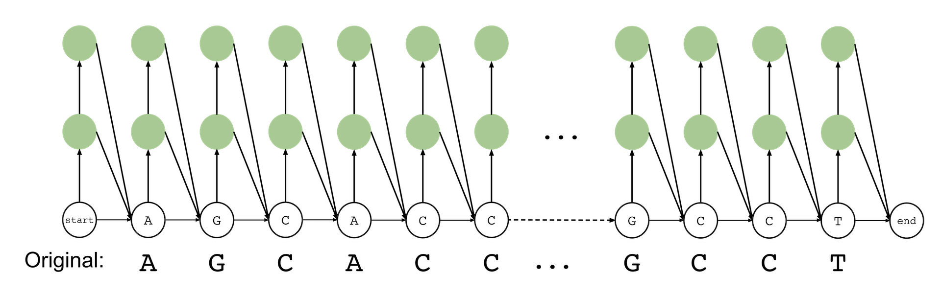
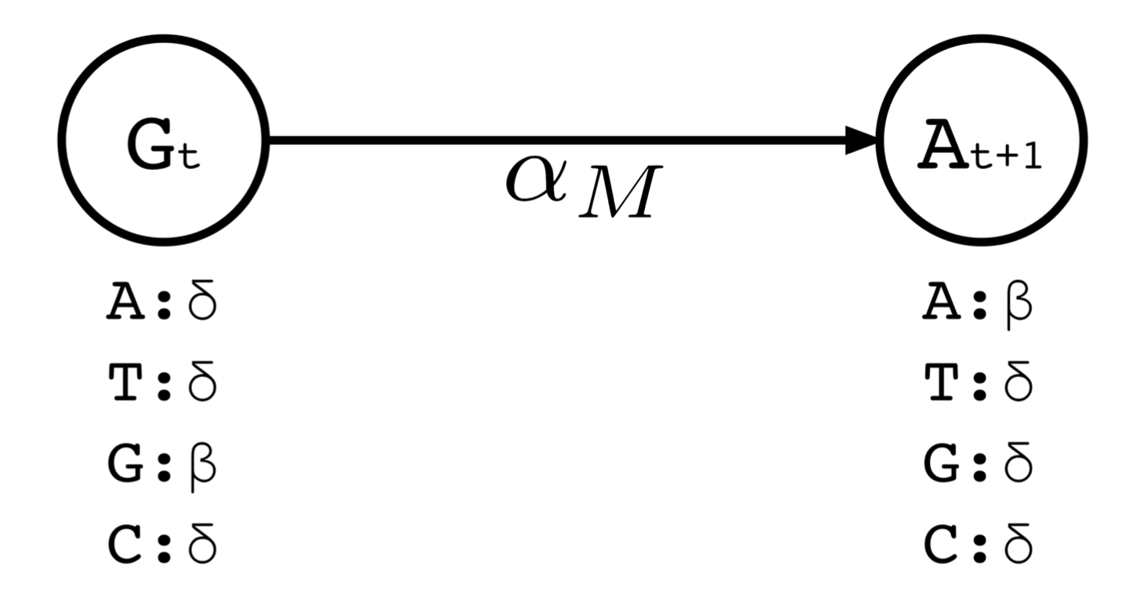
Assembly Polishing using pHMMs
A profile hidden Markov model of the assembly:
AGCACC…GCCT
Parameters to update:
Emission probabilities
Transitions probabilities
Notes:
Let me briefly talk about the main data structure we use in Apollo.
[CLICK]
To represent the probabilities of all possible corrections that a sequence can have at every position, we use a special graph structure called profile hidden Markov models (or pHMMs).
We use pHMMs because it enables us to compare the probabilities of different types of errors at any position (e.g., deletion vs insertion), which is more sensitive than taking a simple majority voting of bases at each position for correcting errors.
[CLICK]
A pHMM graph mainly has three components: states (nodes in the graph), emissions, and directed edges called transitions.
First, A pHMM graph creates at least one state for each character of an assembly sequence so that we can modify (correct) the characters at any position by using probabilistic relation between characters at different positions. For example these two nodes tell us that we have characters G and A at positions t and t+1, respectively.
Second, we assume that when a state is visited, the state outputs (emits) one of the four DNA letters: A, T, G, or C, with a certain probability calculated for each position.
We have emission probabilities to define the probabilities of outputting certain characters when a state is visited.
Last, In order to visit states, we use transitions. These transitions are also assigned with probabilities so that we can calculate the probability visiting a state from a certain state.
Combining all these three components, a pHMM graph provides us with the possibility
[CLICK]
of correcting errors in assemblies by visiting correct states and outputting the correct bases after maximizing the corresponding probabilities assigned to transitions and emissions.

Slide 87
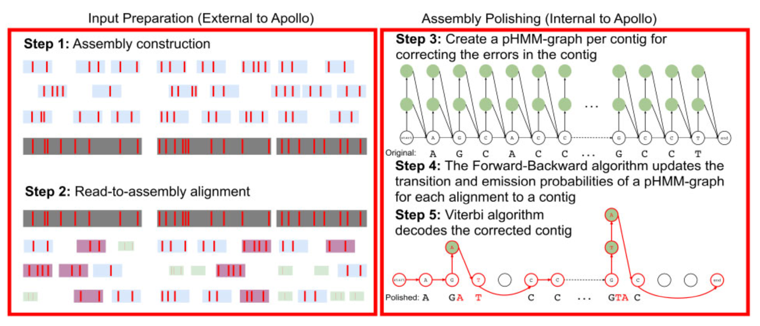
Constructing Accurate de novo Assemblies
Steps external to Apollo
Step 1: Construct de novo assembly using any assembler
Step 2: Align reads to de novo assembly of a genome
Another chance to re-think the consensus choices we make in de novo assembly
Notes:
I will now describe you the workflow to polish an assembly from scratch when using Apollo. Assembly polishing mainly includes five steps. Apollo outsources first two steps and the last three steps are performed by Apollo.
[CLICK]
First, we use an assembler to construct an assembly sequence from erroneous long reads. Here the red tiny rectangles would represent the errors in reads where you can see some of these errors may propagate to the fragments of assembly called contigs shown using dark gray rectangles.
[CLICK]
We re-align these erroneous long reads and any other additional reads (rectangles in different sizes and colors) to contigs. Here the idea is to use contigs as a backbone, which did not exist when generating de-novo assemblies. We assume a reference-based alignment would potentially generate novel information that can help us correct errors in assemblies.
[CLICK]
In Step 3, Apollo takes the de novo assembly constructed in the first step to generate its pHMM graph.
[CLICK]
Here in Step 4, we use the alignment information generated in the second step to update the probabilities in the pHMM graph. There are certain expectation-maximization algorithms such as the Baum-Welch algorithm that would update the probabiltiies using the information we generate from read alignment. This step can be considered as the training step in Apollo.
[CLICK]
We decode (or infer) the consensus string from the pHMM graph after the training step is complete. The consensus string would reveal the modifications that need to be made, which we refer to it as error correction or assembly polishing. The final decoded string is the corrected assembly that Apollo outputs.

Slide 88
Apollo Workflow – Polishing
Step 3: Generate a pHMM graph for a genome assembly
Step 4: Update the probabilities of the pHMM graph using the alignment information from Step 3
Step 5: Use the updated probabilities in pHMM to decode the corrected version of the genome assembly
Notes:
I will now describe you the workflow to polish an assembly from scratch when using Apollo. Assembly polishing mainly includes five steps. Apollo outsources first two steps and the last three steps are performed by Apollo.
[CLICK]
First, we use an assembler to construct an assembly sequence from erroneous long reads. Here the red tiny rectangles would represent the errors in reads where you can see some of these errors may propagate to the fragments of assembly called contigs shown using dark gray rectangles.
[CLICK]
We re-align these erroneous long reads and any other additional reads (rectangles in different sizes and colors) to contigs. Here the idea is to use contigs as a backbone, which did not exist when generating de-novo assemblies. We assume a reference-based alignment would potentially generate novel information that can help us correct errors in assemblies.
[CLICK]
In Step 3, Apollo takes the de novo assembly constructed in the first step to generate its pHMM graph.
[CLICK]
Here in Step 4, we use the alignment information generated in the second step to update the probabilities in the pHMM graph. There are certain expectation-maximization algorithms such as the Baum-Welch algorithm that would update the probabiltiies using the information we generate from read alignment. This step can be considered as the training step in Apollo.
[CLICK]
We decode (or infer) the consensus string from the pHMM graph after the training step is complete. The consensus string would reveal the modifications that need to be made, which we refer to it as error correction or assembly polishing. The final decoded string is the corrected assembly that Apollo outputs.

Slide 89
Evaluation Methodology and Key Results
State-of-the-art polishing tools: Racon, Pilon, Quiver, Nanopolish
Apollo is the only tool that can scale to polish large genomes
Read set: PacBio (35x and 8.9x) and Illumina (22x)
Racon, Pilon and Quiver exceeds memory requirements (192GB) when using high/medium coverage PacBio/Illumina reads
Apollo is the only tool that is scalable to polish large contigs given the memory constraints
Apollo generates the most reliable assemblies
Canu assembler rather than Miniasm
Polish using both long and Illumina reads (i.e., hybrid reads)
Apollo to use hybrid reads
It can use multiple read sets in a single run
Apollo performs better than Nanopolish (~2-5x) but worse than Racon, Pilon, and Quiver (up to 600x, on average ~20-25x)
Notes:
I will briefly share the key results we show in the paper. We compared Apollo to the state-of-the-art assembly polishing tools such as Racon, Pilon, Quiver, and Nanopolish. Nanopolish also uses profile hidden Markov models to calculate the probability of Nanopore events given a sequence.
[CLICK]
First, we show the scalability results when polishing a human genome. We use PacBio reads with 35X and 9X coverage and Illumina reads with 22X coverage. We show that the polishing algorithms cannot complete polishing given the memory constraints we have as they require more than 192GB of memory. We show Apollo is the only algorithm that scales well to polish large genomes as it uses around 60GB of memory to perform the same polishing.
[CLICK]
Second, we also reveal the optimal pipeline that generates the most reliable assemblies from long reads. We show the Canu assembler is preferable compared to Miniasm when construcing the assembly. Furthermore, we show that using hybrid set of reads improves the accuracy of any assembly polishing tool. Here using hybrid set of means that for example we use both PacBio and Illumina reads from the same sample to polish the assembly. We find that Apollo constructs the most reliable assemblies when Canu and hybrid reads are used.
[CLICK]
Third, Apollo performs better than other pHMM-based tool, Nanopolish, but much worse than other polishing algorithms that rely on simple heuristics rather than expensive training and inference steps.

Slide 90
Future Work & Limitations
Parameter optimizations for different sequencing technologies to improve sensitivity
Apollo performs worse due to its computationally expensive training and decoding (inference) steps
Both training and inference algorithms provide massive parallelism opportunities
CPUs are not well suited for efficiently utilizing all available parallelism
Can we do better? Hardware acceleration?

Slide 91

Hardware Acceleration for pHMMs
Can Firtina, Kamlesh Pillai, Gurpreet S. Kalsi, Bharathwaj Suresh, Damla Senol Cali, Jeremie S. Kim, Taha Shahroodi, Meryem Banu Cavlak, Joel Lindegger, Mohammed Alser, Juan Gómez-Luna, Sreenivas Subramoney, and Onur Mutlu, "ApHMM: A Profile Hidden Markov Model Acceleration Framework for Genome Analysis" arXiv, 2022. [Source Code – will be public soon at http://github.com/CMU-SAFARI]
Notes:
You can read the paper for more detailed information and results.

Slide 92
PHMMs in Many Applications
Represent sequence of events with potential modifications to these events
To compare one sequence to many other
To construct the consensus sequence of many sequences
Genomics
Multiple sequence alignment
Protein family search
Error correction
Malware detection
Pattern matching

Slide 93
Comparing a Sequence to Many Sequences
Protein Family:
CSQCGKSFSQSSSLRTHQRIH
YHCSQCGKSFSQSSSLRTHQRIH
YHCSQCGKGFSRSSSLSTHQRIH
YHCSQCGKSFSDSSSLQSHERIH
YYCSQCEKSFNQLSTLQSHQRIH
A Protein Sequence:
YQCDICGKSFSHNGHLVTHNRIH
Too many costly sequence alignment!
Can we do better?

Slide 94
Comparing a Sequence to Many Sequences
Protein Family:
CSQCGKSFSQSSSLRTHQRIH
YHCSQCGKSFSQSSSLRTHQRIH
YHCSQCGKGFSRSSSLSTHQRIH
YHCSQCGKSFSDSSSLQSHERIH
YYCSQCEKSFNQLSTLQSHQRIH
A Protein Sequence:
YQCDICGKSFSHNGHLVTHNRIH
Protein Family:
A Protein Sequence:
YQCDICGKSFSHNGHLVTHNRIH
Single comparison instead of many

Slide 95
Constructing the Consensus Sequence
Hercules [Firtina+, 2018]
Apollo [Firtina+, 2020]
Lanyue+, 2020

Slide 96




Training pHMMs
The Baum-Welch algorithm
Forward Calculation
Backward Calculation
Parameter Updates
Multiple iterations of the Baum-Welch algorithm may be needed for high accuracy
Massive Parallelism: Many states at time t
Time-dependent DP calculations
Transition Probabilities (Constant)
Parallelism: Simple arithmetic operations
Emission Probabilities (Constant)
Data dependency

Slide 97
Motivation
The Baum-Welch algorithm is the common approach for accurate training
The Baum-Welch algorithm is the main source of the performance bottleneck in pHMM-based applications

Slide 98
Goal
Accelerate the Baum-Welch algorithm for pHMMs
Provide an accurate acceleration framework for a wide range of pHMM-based applications
To this end, we propose ApHMM, the first hardware-software co-designed acceleration framework for a wide range of bioinformatics applications that use pHMMs

Slide 99
Key Ideas – PHMM design
Adopt the modified pHMM design to support a wide range of applications
Resolves the complexity and ambiguity issues associated with the commonly-used pHMM design

Slide 100
Key Ideas - Pipelining
Identify and exploit the pipelining opportunities
To minimize the memory overhead
The Backward calculation does not need to be stored
Pipeline for updating transition and emission probabilities

Slide 101
Key Ideas – Cache Reuse
Exploit the iterative nature of the Baum-Welch computations (e.g., Forward)
To minimize the data movement overhead
Improve the cache reuse with loop tiling

Slide 102
Key Ideas – Lookup Tables (LUTs)
Avoid performing the same calculations
Limited combinations of emission and transition multiplications
Use Lookup Tables (LUTs) to minimize the computational overhead

Slide 103
Putting it all together – Hardware Design

Slide 104
System Integration – Many cores

Slide 105
Evaluation Methodology
Hardware accelerator: ApHMM
Implemented in SystemVerilog
Synthesis in a typical 28nm process technology @1GHz
GPU implementation: ApHMM-GPU (CUDA 11.6)
Use cases:
Error correction
Protein Family Search
Multiple Sequence Alignment
Compared to the CPU, GPU, and FPGA implementations
Baseline CPU: AMD EPYC 7742 (7nm) @2.26GHz
Baseline GPUs: NVIDIA A100 and NVIDIA Titan V

Slide 106
Results: Executing the Baum-Welch Algorithm
HW-SW optimizations provide significant improvements in terms of performance and energy consumption
Data movement becomes the bottleneck for the Forward Calculation (fully stored in the L2 cache and DRAM)

Slide 107
Results: Executing the Baum-Welch Algorithm
ApHMM-GPU takes advantage of pHMM-based optimizations when compared to HMM_cuda
Limited speedup for the GPU implementations due to frequent accesses to host for synchronization and sorting (hint for specialized HW design)

Slide 108
Results: Number of ApHMM Cores
4 ApHMM-cores provides the best overall speedup
Data movement overhead starts becoming the bottleneck as we increase the number of cores
Room for the performance improvement by placing ApHMM inside or near the memory

Slide 109
Results: Error Correction
Acceleration where it makes sense: Significant performance and energy improvements for error correction

Slide 110
Results: Protein Family Search
Speedup by 1.61×- 1.75× (CPU) and 1.03× (FPGA)
Lower speedup ratio than error correction due to:
1) Smaller portion is accelerated (45.76%)
2) Increased DRAM access due to larger alphabet size

Slide 111
Results: Multiple Sequence Alignment
Speedup by 1.95× (CPU) and 1.03× (FPGA)
Better speedup ratio than protein family search:
Larger portion is accelerated (51.44%)
ApHMM provides better implementation than FPGA D&C even if we ignore its data movement overheads

Slide 112
Conclusion
Accelerating the Baum-Welch algorithm provides substantial performance improvements and energy reductions
HW-SW co-design provides the best overall performance
Data movement becomes the bottleneck especially for Forward calculation
In-memory or near-memory solutions
Our GPU implementation is the first GPU implementation of the Baum-Welch algorithm designed for pHMMs

Slide 113
Hardware Acceleration for pHMMs
Can Firtina, Kamlesh Pillai, Gurpreet S. Kalsi, Bharathwaj Suresh, Damla Senol Cali, Jeremie S. Kim, Taha Shahroodi, Meryem Banu Cavlak, Joel Lindegger, Mohammed Alser, Juan Gómez-Luna, Sreenivas Subramoney, and Onur Mutlu, "ApHMM: A Profile Hidden Markov Model Acceleration Framework for Genome Analysis" arXiv, 2022. [Source Code – will be public soon at http://github.com/CMU-SAFARI]
Notes:
You can read the paper for more detailed information and results.

Slide 114
Assembly Polishing using ML
Can Firtina, Jeremie S. Kim, Mohammed Alser, Damla Senol Cali, A. Ercument Cicek, Can Alkan, and Onur Mutlu, "Apollo: A Sequencing-Technology-Independent, Scalable, and Accurate Assembly Polishing Algorithm" Bioinformatics, June 2020. [Source Code] [Online link at Bioinformatics Journal]
Notes:
You can read the paper for more detailed information and results.

Slide 115
Prior Research on Genome Analysis (1/2)
Firtina +, "BLEND: A Fast, Memory-Efficient, and Accurate Mechanism to Find Fuzzy Seed Matches”, arXiv, 2021.
Alser +, "SneakySnake: A Fast and Accurate Universal Genome Pre-Alignment Filter for CPUs, GPUs, and FPGAs." to appear in Bioinformatics, 2020.
Senol Cali+, "GenASM: A High-Performance, Low-Power Approximate String Matching Acceleration Framework for Genome Sequence Analysis", MICRO 2020.
Alser+, "Technology dictates algorithms: Recent developments in read alignment", to appear in Genome Biology, 2021.
Kim+, "AirLift: A Fast and Comprehensive Technique for Translating Alignments between Reference Genomes", arXiv, 2020
Alser+, “Accelerating Genome Analysis: A Primer on an Ongoing Journey”, IEEE Micro, 2020.
Notes:
These are all the recent works on genome analysis from our group. You can check these if you are interested in learning more.

Slide 116
Prior Research on Genome Analysis (2/2)
Firtina+, “Apollo: a sequencing-technology-independent, scalable and accurate assembly polishing algorithm”, Bioinformatics, 2020.
Alser+, “Shouji: a fast and efficient pre-alignment filter for sequence alignment”, Bioinformatics 2019.
Kim+, "GRIM-Filter: Fast Seed Location Filtering in DNA Read Mapping Using Processing-in-Memory Technologies”, BMC Genomics, 2018.
Alser+, "GateKeeper: A New Hardware Architecture for Accelerating Pre-Alignment in DNA Short Read Mapping”, Bioinformatics, 2017.
Alser+, "MAGNET: understanding and improving the accuracy of genome pre-alignment filtering”, IPSI Transaction, 2017.

Slide 117
Enabling Accurate, Fast, and Memory-Efficient Genome Analysis via Efficient and Intelligent Algorithms
Can Firtina
canfirtina@gmail.com
27 May 2022
Invited Seminar Talk at UC Berkeley

Slide 118
Backup Slides
118

Slide 119
BLEND – GC Content of Assemblies

Slide 120

BLEND – Read Mapping Quality

Slide 121

BLEND – Read Mapping Accuracy

Slide 122
BLEND – BLEND-I vs. BLEND-S

Slide 123

BLEND – Equal Parameters

Slide 124
BLEND – Equal Parameters

Slide 125

BLEND – Equal Parameters

Slide 126

Resolving deletion errors
Insertion states to insert at most l many bases between two bases in a contig
To insert “GC” between ”CT”
Visit match state at position t and emit C
Visit first insertion state after position t and emit G with deletion error probability
Visit second insertion state and emit C with deletion error probability
From second insertion state visit match state at position t+1 and emit T
Resulting sequence “CGCT”
Maximum number of insertions is a parameter to Apollo

Slide 127

Resolving insertion errors
Deletion transitions to delete one or many bases in a row
To delete the first A in “GAA”
Visit match state at position t and emit G
Visit match state at position t+2 and emit A with single insertion error probability
Resulting sequence: “GA”
Having single or more deletions in a row may not be necessarily equally likely
Maximum number of deletions in a row is a parameter to Apollo

Slide 128



Training
Training data:
Read aligned to the location t of a contig
Assume we have the read “CGT” aligned to location t
After training the corresponding region of the graph we would expect change in the probabilities so that it will be likely to emit “CGT” somehow
CGT

Slide 129

Inference: The Viterbi algorithm
Our original contig before polishing was: “AGCACC…GCCT”
After updating the probabilities, the most likely path from start to end reveals the corrected contig: “AGATCC…GTAC”

Slide 130

Apollo -- Data Sets

Slide 131
Apollo -- Experimental Setup
CPU: Intel®Xeon®Gold 5118 CPU @ 2.30GHz
24 cores (2 threads per core)
Max memory: 192GB
Assigned 45 threads to all tools
Apollo was compared with the state-of-the-art polishing tools
Racon, Pilon, Quiver, Nanopolish

Slide 132
ApHMM – Execution Flow

Slide 133
ApHMM – Storage Distribution

Slide 134

ApHMM – Hardware Configuration

Slide 135

ApHMM – Area and Power Breakdown

Slide 136
Readings, Videos, Reference Materials

Slide 137
Research & Teaching: Some Overview Talks
https://www.youtube.com/onurmutlulectures
Future Computing Architectures
https://www.youtube.com/watch?v=kgiZlSOcGFM&list=PL5Q2soXY2Zi8D_5MGV6EnXEJHnV2YFBJl&index=1
Enabling In-Memory Computation
https://www.youtube.com/watch?v=njX_14584Jw&list=PL5Q2soXY2Zi8D_5MGV6EnXEJHnV2YFBJl&index=16
Accelerating Genome Analysis
https://www.youtube.com/watch?v=r7sn41lH-4A&list=PL5Q2soXY2Zi8D_5MGV6EnXEJHnV2YFBJl&index=41
Rethinking Memory System Design
https://www.youtube.com/watch?v=F7xZLNMIY1E&list=PL5Q2soXY2Zi8D_5MGV6EnXEJHnV2YFBJl&index=3
Intelligent Architectures for Intelligent Machines
https://www.youtube.com/watch?v=c6_LgzuNdkw&list=PL5Q2soXY2Zi8D_5MGV6EnXEJHnV2YFBJl&index=25
The Story of RowHammer
https://www.youtube.com/watch?v=sgd7PHQQ1AI&list=PL5Q2soXY2Zi8D_5MGV6EnXEJHnV2YFBJl&index=39

Slide 138
Accelerated Memory Course (~6.5 hours)
ACACES 2018
Memory Systems and Memory-Centric Computing Systems
Taught by Onur Mutlu July 9-13, 2018
~6.5 hours of lectures
Website for the Course including Videos, Slides, Papers
https://people.inf.ethz.ch/omutlu/acaces2018.html
https://www.youtube.com/playlist?list=PL5Q2soXY2Zi-HXxomthrpDpMJm05P6J9x
All Papers are at:
https://people.inf.ethz.ch/omutlu/projects.htm
Final lecture notes and readings (for all topics)

Slide 139
Longer Memory Course (~18 hours)
TU Wien 2019
Memory Systems and Memory-Centric Computing Systems
Taught by Onur Mutlu June 12-19, 2019
~18 hours of lectures
Website for the Course including Videos, Slides, Papers
https://safari.ethz.ch/memory_systems/TUWien2019
https://www.youtube.com/playlist?list=PL5Q2soXY2Zi_gntM55VoMlKlw7YrXOhbl
All Papers are at:
https://people.inf.ethz.ch/omutlu/projects.htm
Final lecture notes and readings (for all topics)

Slide 140
An Interview on Research and Education
Computing Research and Education (@ ISCA 2019)
https://www.youtube.com/watch?v=8ffSEKZhmvo&list=PL5Q2soXY2Zi_4oP9LdL3cc8G6NIjD2Ydz
Maurice Wilkes Award Speech (10 minutes)
https://www.youtube.com/watch?v=tcQ3zZ3JpuA&list=PL5Q2soXY2Zi8D_5MGV6EnXEJHnV2YFBJl&index=15

Slide 141
More Thoughts and Suggestions
Onur Mutlu, "Some Reflections (on DRAM)" Award Speech for ACM SIGARCH Maurice Wilkes Award, at the ISCA Awards Ceremony, Phoenix, AZ, USA, 25 June 2019. [Slides (pptx) (pdf)] [Video of Award Acceptance Speech (Youtube; 10 minutes) (Youku; 13 minutes)] [Video of Interview after Award Acceptance (Youtube; 1 hour 6 minutes) (Youku; 1 hour 6 minutes)] [News Article on "ACM SIGARCH Maurice Wilkes Award goes to Prof. Onur Mutlu"]
Onur Mutlu, "How to Build an Impactful Research Group" 57th Design Automation Conference Early Career Workshop (DAC), Virtual, 19 July 2020. [Slides (pptx) (pdf)]

Slide 142
Reference Overview Paper
Onur Mutlu, Saugata Ghose, Juan Gomez-Luna, and Rachata Ausavarungnirun, "A Modern Primer on Processing in Memory" Invited Book Chapter in Emerging Computing: From Devices to Systems - Looking Beyond Moore and Von Neumann, Springer, to be published in 2021.
https://arxiv.org/pdf/1903.03988.pdf

Slide 143

Reference Overview Paper I
Onur Mutlu, Saugata Ghose, Juan Gomez-Luna, and Rachata Ausavarungnirun, "Processing Data Where It Makes Sense: Enabling In-Memory Computation" Invited paper in Microprocessors and Microsystems (MICPRO), June 2019. [arXiv version]
https://arxiv.org/pdf/1903.03988.pdf

Slide 144

Reference Overview Paper II
Saugata Ghose, Amirali Boroumand, Jeremie S. Kim, Juan Gomez-Luna, and Onur Mutlu, "Processing-in-Memory: A Workload-Driven Perspective" Invited Article in IBM Journal of Research & Development, Special Issue on Hardware for Artificial Intelligence, to appear in November 2019. [Preliminary arXiv version]
https://arxiv.org/pdf/1907.12947.pdf

Slide 145

Reference Overview Paper III
Saugata Ghose, Kevin Hsieh, Amirali Boroumand, Rachata Ausavarungnirun, Onur Mutlu, "Enabling the Adoption of Processing-in-Memory: Challenges, Mechanisms, Future Research Directions" Invited Book Chapter, to appear in 2018. [Preliminary arxiv.org version]
https://arxiv.org/pdf/1802.00320.pdf

Slide 146

Reference Overview Paper IV
Onur Mutlu and Lavanya Subramanian, "Research Problems and Opportunities in Memory Systems" Invited Article in Supercomputing Frontiers and Innovations (SUPERFRI), 2014/2015.
https://people.inf.ethz.ch/omutlu/pub/memory-systems-research_superfri14.pdf

Slide 147

Reference Overview Paper V
Onur Mutlu, "The RowHammer Problem and Other Issues We May Face as Memory Becomes Denser" Invited Paper in Proceedings of the Design, Automation, and Test in Europe Conference (DATE), Lausanne, Switzerland, March 2017. [Slides (pptx) (pdf)]
https://people.inf.ethz.ch/omutlu/pub/rowhammer-and-other-memory-issues_date17.pdf

Slide 148

Reference Overview Paper VI
Onur Mutlu, "Memory Scaling: A Systems Architecture Perspective" Technical talk at MemCon 2013 (MEMCON), Santa Clara, CA, August 2013. [Slides (pptx) (pdf)] [Video] [Coverage on StorageSearch]
https://people.inf.ethz.ch/omutlu/pub/memory-scaling_memcon13.pdf

Slide 149

Reference Overview Paper VII
Proceedings of the IEEE, Sept. 2017
https://arxiv.org/pdf/1706.08642

Slide 150

Reference Overview Paper VIII
Onur Mutlu and Jeremie Kim, "RowHammer: A Retrospective" IEEE Transactions on Computer-Aided Design of Integrated Circuits and Systems (TCAD) Special Issue on Top Picks in Hardware and Embedded Security, 2019. [Preliminary arXiv version] [Slides from COSADE 2019 (pptx)] [Slides from VLSI-SOC 2020 (pptx) (pdf)] [Talk Video (30 minutes)]

Slide 151
Related Videos and Course Materials (I)
Undergraduate Digital Design & Computer Architecture Course Lecture Videos (2020, 2019, 2018, 2017, 2015, 2014, 2013)
Undergraduate Digital Design & Computer Architecture Course Materials (2020, 2019, 2018, 2015, 2014, 2013)
Graduate Computer Architecture Course Lecture Videos (2019, 2018, 2017, 2015, 2013)
Graduate Computer Architecture Course Materials (2019, 2018, 2017, 2015, 2013)
Parallel Computer Architecture Course Materials (Lecture Videos)

Slide 152
Related Videos and Course Materials (II)
Seminar in Computer Architecture Course Lecture Videos (Spring 2020, Fall 2019, Spring 2019, 2018)
Seminar in Computer Architecture Course Materials (Spring 2020, Fall 2019, Spring 2019, 2018)
Memory Systems Course Lecture Videos (Sept 2019, July 2019, June 2019, October 2018)
Memory Systems Short Course Lecture Materials (Sept 2019, July 2019, June 2019, October 2018)
ACACES Summer School Memory Systems Course Lecture Videos (2018, 2013)
ACACES Summer School Memory Systems Course Materials (2018, 2013)

Slide 153
Some Open Source Tools (I)
Rowhammer – Program to Induce RowHammer Errors
https://github.com/CMU-SAFARI/rowhammer
Ramulator – Fast and Extensible DRAM Simulator
https://github.com/CMU-SAFARI/ramulator
MemSim – Simple Memory Simulator
https://github.com/CMU-SAFARI/memsim
NOCulator – Flexible Network-on-Chip Simulator
https://github.com/CMU-SAFARI/NOCulator
SoftMC – FPGA-Based DRAM Testing Infrastructure
https://github.com/CMU-SAFARI/SoftMC
Other open-source software from SAFARI
https://github.com/CMU-SAFARI/
http://www.ece.cmu.edu/~safari/tools.html

Slide 154
Some Open Source Tools (II)
MQSim – A Fast Modern SSD Simulator
https://github.com/CMU-SAFARI/MQSim
Mosaic – GPU Simulator Supporting Concurrent Applications
https://github.com/CMU-SAFARI/Mosaic
IMPICA – Processing in 3D-Stacked Memory Simulator
https://github.com/CMU-SAFARI/IMPICA
SMLA – Detailed 3D-Stacked Memory Simulator
https://github.com/CMU-SAFARI/SMLA
HWASim – Simulator for Heterogeneous CPU-HWA Systems
https://github.com/CMU-SAFARI/HWASim
Other open-source software from SAFARI
https://github.com/CMU-SAFARI/
http://www.ece.cmu.edu/~safari/tools.html

Slide 155

More Open Source Tools (III)
A lot more open-source software from SAFARI
https://github.com/CMU-SAFARI/
http://www.ece.cmu.edu/~safari/tools.html

Slide 156



Slide 157
Referenced Papers, Talks, Artifacts
All are available at
https://people.inf.ethz.ch/omutlu/projects.htm
http://scholar.google.com/citations?user=7XyGUGkAAAAJ&hl=en
https://www.youtube.com/onurmutlulectures
https://github.com/CMU-SAFARI/

Slide 158
An Interview on Research and Education
Computing Research and Education (@ ISCA 2019)
https://www.youtube.com/watch?v=8ffSEKZhmvo&list=PL5Q2soXY2Zi_4oP9LdL3cc8G6NIjD2Ydz
Maurice Wilkes Award Speech (10 minutes)
https://www.youtube.com/watch?v=tcQ3zZ3JpuA&list=PL5Q2soXY2Zi8D_5MGV6EnXEJHnV2YFBJl&index=15

Slide 159
More Thoughts and Suggestions
Onur Mutlu, "Some Reflections (on DRAM)" Award Speech for ACM SIGARCH Maurice Wilkes Award, at the ISCA Awards Ceremony, Phoenix, AZ, USA, 25 June 2019. [Slides (pptx) (pdf)] [Video of Award Acceptance Speech (Youtube; 10 minutes) (Youku; 13 minutes)] [Video of Interview after Award Acceptance (Youtube; 1 hour 6 minutes) (Youku; 1 hour 6 minutes)] [News Article on "ACM SIGARCH Maurice Wilkes Award goes to Prof. Onur Mutlu"]
Onur Mutlu, "How to Build an Impactful Research Group" 57th Design Automation Conference Early Career Workshop (DAC), Virtual, 19 July 2020. [Slides (pptx) (pdf)]

Slide 160
End of Backup Slides

